Slide 1
Performance Management – the ‘not so new’ workplace tyranny
Professor Phil Taylor
University of Strathclyde
Manchester Industrial Relations Society
17 October 2013

Slide 2
Performance Management – STUC Report
Workers subject to new forms of Performance Management (PM)….causing mental-ill health?
Nothing on effect on workers – original research
5 years since crash and crisis of neo-liberalism => austerity, privatisation frenzy, dismantlement of welfare, unemployment, cuts, etc – but resistance
(Great tricksters – Penn &Teller (Cameron & Osborne)
UK Gini co-efficient (0.36 – 0.34 - 2010-11) the largest growth in income inequality in 50 years

Slide 3
Post-2008 ‘Can’t we just get back to normal?’
Misunderstanding nature and depth of crisis
More than ‘disconnected capitalism’ (Thompson, 2003) or ‘financialisation’ (Harman, 2009; Kliman, 2012)
Hyman (1987) referred to ‘the new normalcy’ – the new disciplines imposed on workers post-1980’s crisis
Now the shaping of new structures of accumulation post-crisis of 2007-8
Senses in which ‘the new normal’ is now being used
Not just a turn of the business cycle but a redrawing of the political-economic landscape

Slide 4
ConDems’ attack on worker rights based on the fallacy of the red tape challenge
Easier to hire and workers good for the economy
unfair dismissal weakened – qualifying period to 2 years affecting 2.7 m. workers
‘no fault dismissals’ – Beecroft – employers wouldn’t have to show that employers were guilty of misconduct
no disciplinary procedure – no right to appeal at ET (except on discrimination) – wholly arbitrary
‘Grown Up’ or ‘Protected Conversations’ - employees can’t raise in future tribunal case – will reinforce bullying
fees for employment tribunal users – is deterring workers from claims & undermining workplace rights

Slide 5
Young Report - excluded from official view – are the ‘low hazard workplaces’
The scandal of zero hours contracts
Legal changes inseparable from the managerial offensive on the ‘front-line’ of work
Offensive has at least three integrated elements: Performance Management
Lean Working
Sickness Absence Management
Convergence - white-collar workers and manual workers and technical workers and professionals

Slide 6
Employers’ Cost Reduction Strategies ‘STAR’
Outsourcing/
Offshoring
Inferior
Terms and Conditions
Automation
Work Intensification, Lean, PM and SAP

Slide 7
Lean, Performance Management and
Work Intensification
Integrated managerial offensive that is squeezing increasing effort out of workers
Cost-cutting strategies are being translated into an unprecedented intensification of work
Restructuring, re-engineering ,‘lean’, creative synergies
Equivalent or larger volumes of work being done with the same or - more likely - smaller workforces
Sheer intensity of effort taking place - closing the ‘porosity’ of working time (Marx Capital volume 1)

Slide 8
1) Lean Working
Core thesis – organisations which strip out waste gain significant quality and efficiency advantages = Toyota
Rhetoric of multi-skilling, task enlargement, worker participation in kaizen (Womack et al, 1990)
Lean’s claim to remove mind-numbing stress with ‘creative stress’ - ‘work smarter, not harder’ mantra
Yet workers’ experiences in autos (Stewart et al, 2009)
- tighter supervisory control - narrow tasking
- job stress - managerial bullying - lack of voice
- ‘traffic lights’ – workers on the edge
‘Consultemics’ applying lean efficiencies to public sector, FS, NHS, HE etc. (Radnor and Walley, 2010)

Slide 9
In HMRC lean created a brutal form of ‘Taylorism’
Lean consultants – McKinsey, Unipart
After Lean 95% say work ‘very’/‘quite’ pressurised
Pressure had increased ‘a great deal’ – 76%
‘…you would be given a pile of post and you could manage it yourself. Most people would flick through and – ‘that looks a bit hard, I’ll put that to the back, do it this afternoon’...You would give your daily results to your manager. Now they want to know what you’ve done every hour, which…you can’t manage things because some things take an hour and one minute, so in the first hour you’ve done zero….’
Statistical relationship between work intensity, time spent at work station, coming to work ill and frequency of symptoms (Carter et al, 2013)

Slide 10
Ill-health Symptoms and Time at Work Station
% of time at work station
<85% 85-95% >95%
Daily/several times a week
Mental fatigue*** 47 42 62
Physical tiredness*** 45 43 62
Stiff shoulders 28 38 45
Stiff neck** 29 38 47
Stress** 31 33 42
Backache* 25 32 44
Headaches 21 26 33
Pain/numbness in arms/wrists* 17 24 31
Eyesight problems* 15 19 29
Blocked nose** 5.0 15 22
Almost half spend more than 95% of time at work station

Slide 12
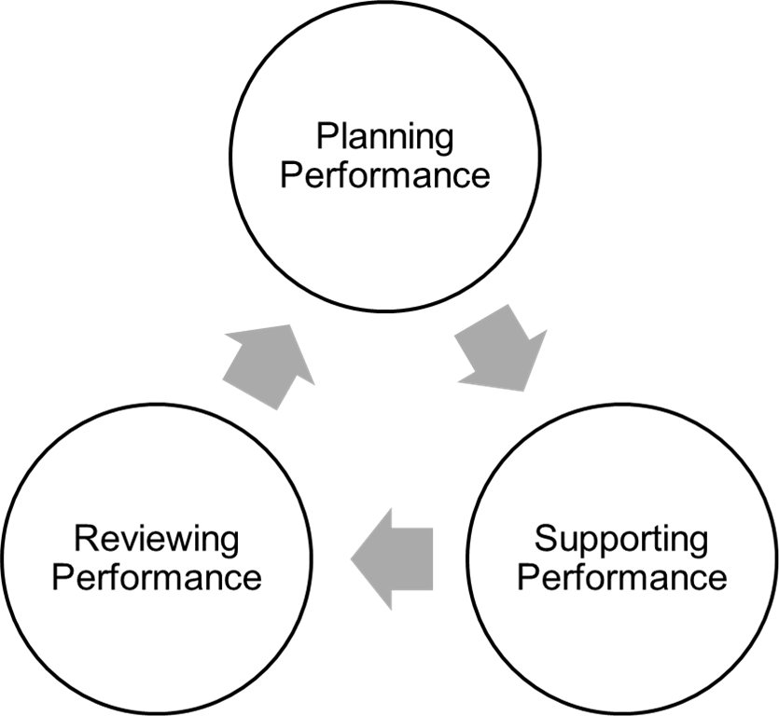
2) Performance Management
Measurement of performance central to management
Alignment of individual with organisational objectives
HRM texts read like 1984 - ‘Agreed’, ‘shared’, ‘mutual expectations’, ‘dialogue’, ‘support’, ‘guidance’

Slide 13
PM synonymous with Performance Appraisal- an ‘annual ritual’, reviews now more frequent
Always a problem with subjectivity – who decides?
Managing ‘underperformance’ ‘a positive process’ (Torrington et al, 2011) and in texts published 2013
PM has become continuous, backward looking and forward looking with a serious disciplinary purpose
Performance Improvement, PIPs, Managing Performance, PIMs, IIPs – the real bite in PM
In some organisations now 3rd generation PIPs

Slide 14
Micro-measurement and micro-management of individual performance – facilitated by technologies
Quantitative outputs and targets – AHTs, CHTs etc.
KPIs, SLAs – determined at the top, ‘cascade down’ through tiers of managers, to TLs and then workers
Reducing the discretion of FLMs – tight links in the chain of command – ‘nothing to do with me’
The example of ‘flow controllers’ instead of TLs
Managers themselves given targets for the numbers of ‘managed exits’, underperformers, SAP actions etc.
What is bullying? Is it 1-1 relationships or systemic?
Even the so-called measurables are ‘pseudo-science’ - parameters and definitions set by management
Notes:
Hegel Hoel and Davis Beale

Slide 15
Management obsession with ‘measurables’, metrics’, ‘deliverables’, ‘metrics’, ‘stats’, ‘MIS’
Quantitative measures are strictly imposed
Evidence from FS and telecoms that targets first systemically used in contact centres then spread to the back office and widely across functions
HMRC– 6 tax cases an hour, 80 for opening letters
BT engineers – tightly timed jobs, monitoring – India and UK example
Universities – workload models, ‘dashboards’, REF
Pre-dated the crisis but accelerated by it
‘The new normal’ of ‘doing more with less’

Slide 16
Qualitative behaviours, attitudes and traits
In one finance sector company there were 13 ‘measurable’ quality criteria including –
‘delight the customer’, ‘speaks up’, ‘shares ideas’
‘Do what is right for the customer, community
and organisation, putting aside own agenda’
‘Act like the owners of the business…’
‘having heart’ ‘achieving excellence’, building trust’
Greater room for subjectivity and ulterior motives
‘leaves people vulnerable to the whim of a supervisor’
(Telecoms Regional Officer)

Slide 18
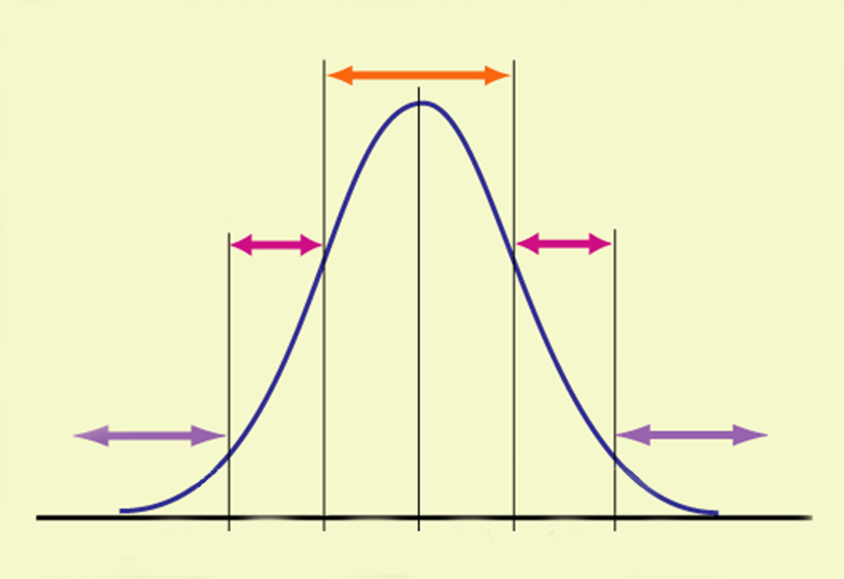
The Performance Management Bell Curve
Meets
expectations
Below
expectations
Above
expectations
Serious under
performance
Excellent
performance
10%
15%
50%
15%
10%

Slide 19
Bank A – Expected Performance Ratings

Slide 20
BT – Performance Ratings (2102-13)

Slide 21
‘The language is specific, “You have not achieved, you are an underachiever’”.
Widespread discontent and more evidence of contesting rankings and ratings
Frontier of control – ever moving goalposts
‘Round table process’ or ‘calibration’ to prevent FLMs inflating scores – fixed pot of money
Ethnic, age, part-time, disability discriminations (Prospect)
Scale of intimidation – in one bank 10% on actions
‘War for Talent’ (Michaels et al, 1997) – get rid of 10% - the McKinsey hegemony

Slide 22
‘There was quite a sinister practice that we were to use – the car-park conversation. A manager would be expected to take an employee, who had received poor performance score, outside for an informal discussion. The manager would then start a conversation along the lines of, ‘You know your last review. It’s only going one way, isn’t it? You should perhaps think about coming to an arrangement’. It was important that the manager would never make any explicit suggestion that the worker should leave. We were given training in how to conduct these conversations; a one-day course on employee relations for HR managers, where we would go through the best mechanisms for ensuring that an employee would voluntarily suggest a compromise agreement’. (Ex-HR Manager, BT)

Slide 23
Consequences for Workers
‘If your name is up on the whiteboard, you’ll have emails going saying who is performing badly and who is performing well, who is red, who is amber, who is green, that kind of thing, so the pressure is very intense and it really does affect people badly’ (Bank A, National Officer)
‘There is a culture in our workplace of managers using extreme, derogatory language. Don’t get me wrong, there are decent ones, but they are overshadowed by the aggressive ones...downright nasty, horrible stuff – ‘bottom feeders’ for those on the lowest rankings’ (Rep)

Slide 24
Conclusion
Strategies using punitive PM and SAPs are short-termist but are driven by cost-cutting
Opposition at different levels – multi-faceted
Business/soft-HRM case –huge commitment of managers’ time with questionable outcomes
The Bell curve to be rejected as inapplicable to employee performance – in principle and practice
Potentially discriminatory – DDA, Equality and Age – conduct audits of rankings by gender, age, status
Unions – at workplace level – actively challenging unfair rankings, before the event as well as after

Slide 25
Appeal, appeal, appeal – break the culture of people individualising their scores/ranks
H&S and stress audits can be an organisational tool – working conditions and ill-health inseparable
Broader opposition to Beecroft, protected conversations and erosion of employment rights
Public exposure of the worst cases of ‘new tyranny in the contemporary workplace’ – name and shame
National level - CWU and industrial action
Opportunities for organising and recruiting in unionised and non-unionised environments

Slide 26
The Vicious Circle
Intensification of work & insecurity
Contributes to illness
Coming to work when ill
SAP
Makes condition worse
PM & so-called underperformance
Increases insecurity & likelihood of disciplinary
Mental ill-health

Slide 27
Michaels, E., Handfield-Jones, H. and Axelrod, B. (2001) The War for Talent, Harvard Business School
Pollert, A. (1989) ‘The flexible firm – fixation or fact’, Work, Employment and Society, 3.1
Radnor, Z. (2010) ‘Transferring lean into government’ Journal of Manufacturing Technology Management, 21:411-428
Stewart, P. et al (2008) “We sell out time no more”: workers’ struggles against lean production in the British car industry, London: Pluto
Taylor, P., Cunningham, I., Newsome, K. and Scholarios, D. (2010) ‘”Too scared to go sick” – reformulating the research agenda on sickness absence’, Industrial Relations Journal, 41(4):270-288
Thompson, P. (2003) ‘Disconnected capitalism: or why employers can’t keep their side of the bargain’, Work, Employment Society, 17.2: 359-78

Slide 28
Torrington, D., Hall., L. and Taylor, S. and Atkinson, C. (2011) ‘Employee Performance Management’ in Human Resource Management (8th edition), London: Prentice Hall, pp.263-286
Womack, J.D., Jones, D.T. and Roos, D. (1990) The Machine that Changed the World: The Triumph of Lean Production, New York:Rawson Macmillan

