Slide 1

Manchester Industrial Relations Society
Employee Engagement: Challenges and Opportunities
MMUBS
11th December 2014
Peter Cheese
CEO CIPD
Notes:
See covering sheet for a more thorough introduction to the purpose and suggested usage of this presentation

Slide 2

A new set of ‘norms’
Workplace
Work
Value
Economy
Workforce
More volatile and less predictable
Increasingly
Increasingly
Continued shift toward Intangibles
Networked, Collaborative, Flexible
Increasingly
Increasingly
Formal Organization and Informal Social System Structures
Increasingly
More diverse, more demanding

Slide 3
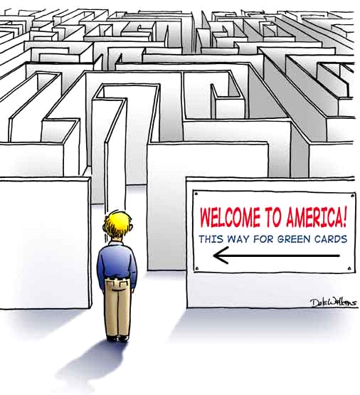
So are our People Management practices good enough?
Source
Attract
Select
Orient
Train
Develop
Reward
Move through the Organization
Welcome to our Company
Orientation begins here
Where are your biggest challenges today?
Where will they be tomorrow?

Slide 4
Engagement - A rose by any other name…
Voice Empowerment Recognition Support Playing to strengths Meaning Purpose
Well-being Energy! The extra mile Passion Alignment Collaboration Shared values Commitment
Trust
Notes:
See covering sheet for a more thorough introduction to the purpose and suggested usage of this presentation
4

Slide 5
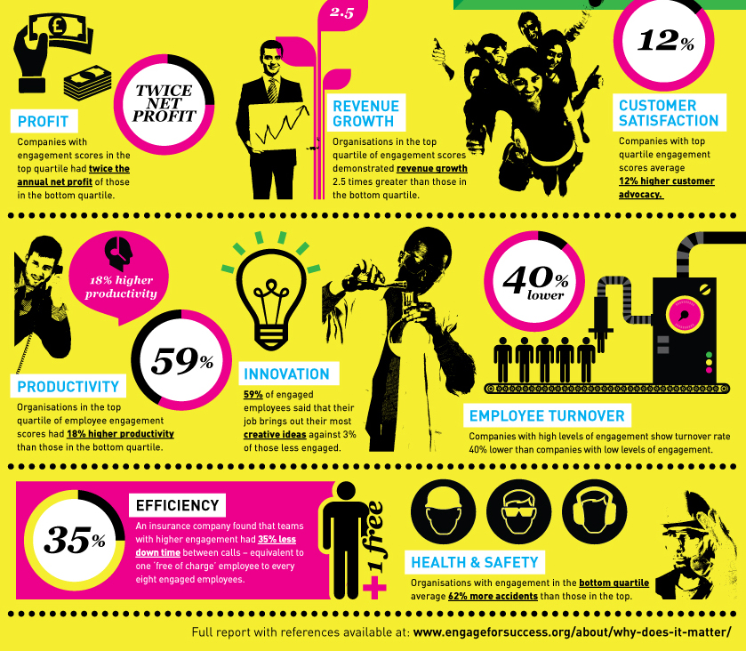


Slide 6
An engagement deficit?
CIPD Employee Outlook survey, Spring 2014
Notes:
See covering sheet for a more thorough introduction to the purpose and suggested usage of this presentation
6

Slide 7
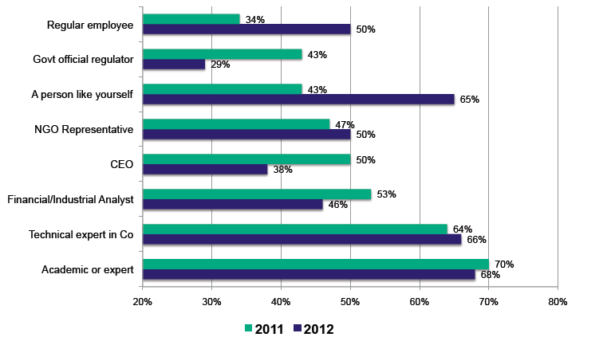
A crisis of trust?
Edelman Trustbarometer 2012

Slide 8
A crisis of trust?
Edelman Trustbarometer 2012
Banking crisis
Food chain corruption
Phone hacking
MPs expenses
NHS scandals
Price fixing
Media scandals

Slide 9
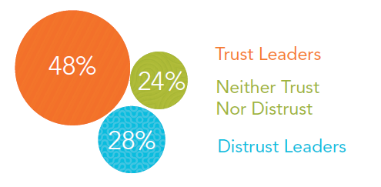
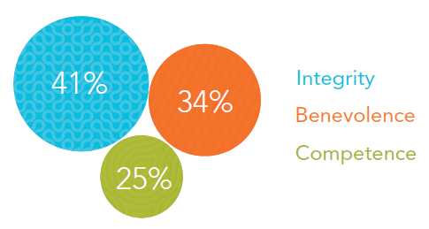
Rebuilding Trust
Prevalence of Trust in Leaders
Factors that drive trust
Kennexa Work Trends Report 2013
Ethical behaviour seen to be an issue
  Fewer than two-fifths of CEOs have ethics at the heart of business decisions
  Half say their organisation prioritises financial performance over ethics
ILM/Management Today Trust Index 2012

Slide 10
Other contextual drivers
WERS
Notes:
See covering sheet for a more thorough introduction to the purpose and suggested usage of this presentation
10

Slide 11

What drives transformational engagement?
Drivers of Engagement
Purpose
Autonomy
Mastery
Enabled by
Leadership providing a strong strategic narrative
Engaging managers who focus on their people and give them scope
Employee voice throughout the organisation
Employee wellbeing – physical, mental, emotional
Organisational integrity – values are reflected in behaviours throughout

Slide 12
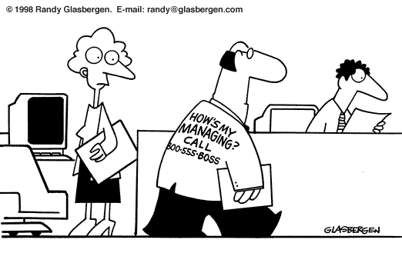
The essential role of the manager

Slide 13

Employee Voice – a two way process
Individual and collective
Forums, surveys
Representative bodies
Social media – internal and external
Projects and processes

Slide 14
The importance of measurement and insight
SHOW ME THE NUMBERS!
What gets measured gets done
But not everything that can be counted counts
Too much data, too little insight
Notes:
See covering sheet for a more thorough introduction to the purpose and suggested usage of this presentation
14

Slide 15
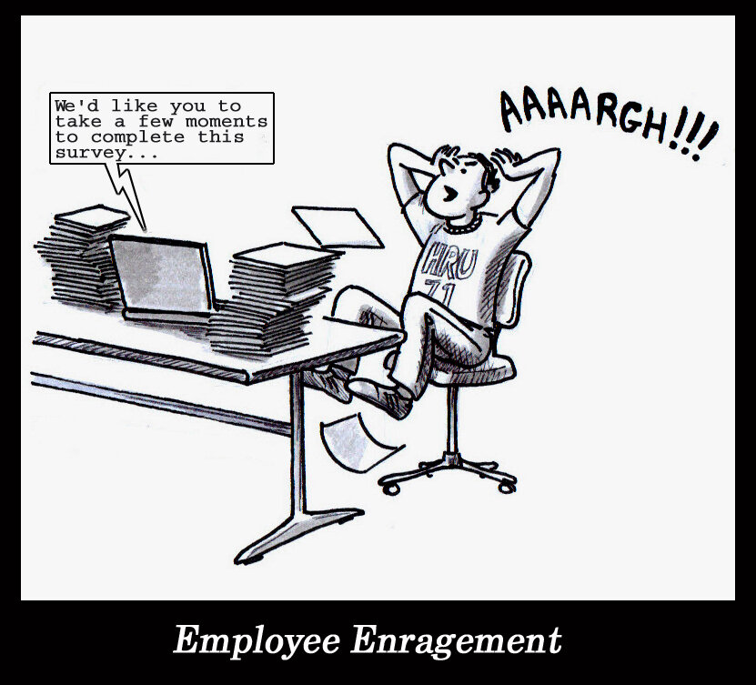
Measuring engagement – what’s important
@SimonHeath1
Notes:
See covering sheet for a more thorough introduction to the purpose and suggested usage of this presentation
15

Slide 16
In conclusion…
Engagement is a strategic issue
Starts from the top, links to purpose and values, roles, opportunity, recognition
Need measures that provide visibility and insight
Develop and train managers, and hold them accountable
Provide for the continual channels of feedback, employee voice

