Slide 1
European Industrial Relations after state tradition?
An assessment of international pressures on the six largest EU member states, 1992-2012
Guglielmo Meardi

Slide 2
‘Social Europe’, twenty years after
1992: Maastricht Treaty + Social Protocol
1993: Crouch’s Industrial Relations & European State Traditions
      1. guild legacies => corporatism
      2. market before industrialisation => fragmented voluntarism
      3. conflict state-Catholic Church => divided political unions
Implications:
  historical continuity and endogenous change
  peak of methodological nationalism in IR

Slide 3
Implication: dismissal of the transnational
Crouch (1993) on EU:
  Will the 1992 project for a single internal market within the European Community have a more profound effect [on national IR]?
  It reaches deeper into the political process, and the EC tends to prefer neo-corporatist patterns since these give it a range of interlocuteurs who help remedy its popular deficit.
  But to date there is little sign that systematic differences of approach to the occupancy of political space are even perceived by policy-makers, let alone have become an object of harmonization.’ (p.350)
Messina (1990) on migration:
  End of labour migration in Europe, and of European Commission’s promotion of free movement
Castles (1986) on migration:
  The Guest-Worker in Western Europe: An Obituary
Hirst & Thomson (1996) on multinational companies:
  No transnational corporations, only international ones

Slide 4
Reassessment:
Analysis of 3 patterns
Since then, internationalisation of the 3 main actors:
  Capital: multinationals (FDIx8)
  Labour: migration, free movement of labour/services (x2 after 2004)
  State: supranational regulations (Social Protocol, EMU; European Employment Strategy, structural reforms)
Focus on the 6 largest EU countries (71% of EU population):
  comparability reasons (weight of trade, heterogeneity, weight in EU)
  Methodological reason (historical/qualitative)

Slide 5
I - multinationals
 | FDI % of GDP | FDI inflows % of capital formation | FDI outflows % of capital formation | Change 1990-2010 | MNC % of private employment | Overall weight | IR effects
D | 20 | 7 | 13 | 6x | 10 | Medium | Medium-low
F | 39 | 13 | 22 | 10x | 20 | High | Medium
UK | 48 | 23 | 24 | 5x | 20 | High | Medium
I | 16 | 5 | 9 | 6x | 5 | Low | Medium-low
E | 44 | 12 | 17 | 10x | 10 | High | Medium
PL | 41 | 18 | 4 | 2000x | 20 | High | High

Slide 6
Lobbying
American Chambers of Commerce:
  Strong voice in Brussels, relevant but adaptive in D, PL, I and E, silent in F and UK
  More effort in playing the system, than changing it
MNC influence on employer confederations:
  Very strong in Poland
  Substantial in France

Slide 7
Extreme case: Fiat exit from Italian system (2010-12)
Internationalisation (Italo-American CEO, Chrysler take-over, from 2014 legal HQ in NL and tax registration in UK)
relocation threats, new plant agreements
  exit from national collective bargaining
    exit from Confindustria
      exit from national agreement on workplace union representation, expulsion of FIOM-CGIL
        knock-on effect on Confindustria: -12% membership fees

Slide 8
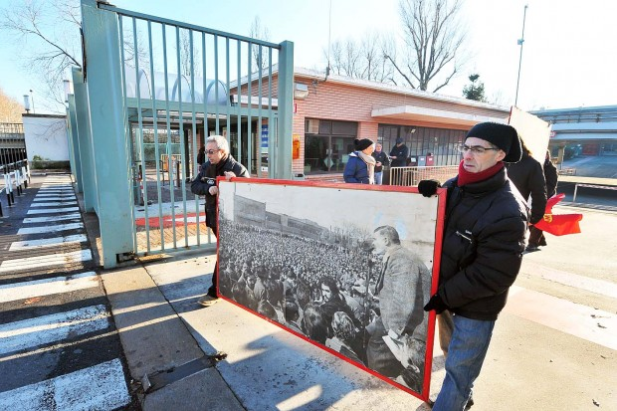

Slide 9
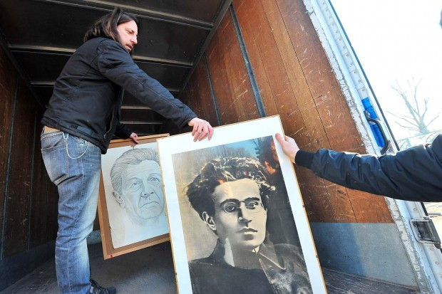

Slide 10
II – Labour movement
 | % Foreign-born | % new employment | Overall size | IR Effects
D | 15 | 19 | Medium | High
F | 12 | 12 | High | Medium
UK | 13 | 65 | High | High
I | 8 | 22 | Medium | Medium
E | 15 | 29 | High | Medium
PL | 0.5 | 1 | High (exit) | Medium

Slide 11
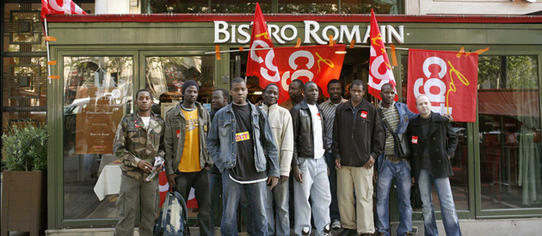
States & unions vs migrants
Legislative reactions:
  Adaptation and even strengthening of regulations: gangmaster licencing in UK, min. wages in D, subcontracting rules in E
Unions avoid turning into ‘insiders’ fortress’
Differences:
  Models of citizenship, unionism, politics
    different frames of approach to migrants (multiculturalism, social rights, corporatism) (Brubaker, Schnapper)
    different tools (campaigns, strikes, social partnership)
    different positions on regularisation, freedom of movement

Slide 12
III – EU
 | EES Recommendations | ‘World of Compliance’ (Falkner)
D | Few | Domestic politics
F | Some | Neglect
UK | Few | Domestic politics
I | Strong | Dead letters
E | Strong | Domestic politics
PL | Few | Dead letters

Slide 13
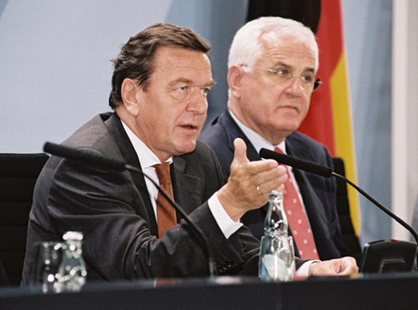
EES: a 1997 turning point?
 | Average, EU14 |  |  | Variance, EU14
 | 1987 | 1997 | 2007 | 1987 | 1997 | 2007
Flexibility | 2.78 | 2.25 | 2.05 | 1.07 | 0.79 | 0.53
ALMP | 13.57 | 11.46 | 13.69 | 19.37 | 8.16 | 8.94
Security | 30.8 | 33.2 | 34.5 | 206 | 153 | 119
Flexibility: OECD Employment Protection Law (regular contracts) Index
ALMP: expenditure intensity (OECD)
Security: replacement rate (OECD)
No decisive EU direct effect:
countries with best employment performance 1997-2007 (D, I, E) follow national reform paths
(e.g. Hartz reforms as ‘typical German reforms’)
Vice-versa: Blair-Schröder Paper’s influence on the EU

Slide 14
Structural reforms
Italy & Spain, 2011-12 labour market & collective bargaining reforms under ECB/EC pressure:
The EU achieves in few months what employers and right-wing governments didn’t even dare to ask
Deeper reforms in Spain (power balance, state structure)
Evidence of unintended consequences (undermining of industrial districts, conflict)
Resistance/inertia even from employer associations:
  hostility to company-level negotiation
  disruption of networks (industrial districts)
  attachment to workforce segmentation as a management tool

Slide 15
The Variety of IR
state
F
E
PL
I
UK
D
associations

Slide 16
Associations
1992 | TUDens | EmplDens | CBCov | Coord | Centr(level) | Artic
Germany | 43 | 68 | 81.4 | 4 | 3 | 2
Italy | 38.9 | 66 | 85 | 4 | 4 | 4
France | 9.8 | 74 | 94.5 | 2 | 2 | 2
UK | 39.8 | 40 | 40 | 1 | 2 | 3
Poland | 29.7 | 20 | 42 | 1 | 1 | 1
Spain | 16.5 | 72 | 79 | 2 | 3 | 2
2012
Germany | 18 | 58 | 61.1 | 4 | 3 | 2
Italy | 35.2 | 58 | 85 | 3 | 3 | 4
France | 7.9 | 75 | 92 | 2 | 2 | 2
UK | 27.1 | 35 | 35 | 1 | 1 | 1
Poland | 14.1 | 20 | 28.9 | 1 | 1 | 1
Spain | 15.60 | 75 | 73.2 | 4 | 4 | 2

Slide 17
State
1992 | MW | MW% | WC | GovInt | Ext | EPL(r) | EPL(t) | UnBen | SocExp | SPact | TriC | PS% | PSreg
D | 0 | 0 | 2 | 2 | 1 | 2.58 | 3.25 | 29 | 21.7 | 0 | 0 | 0.20 | 0.71
I | 0 | 0 | 2 | 4 | 3 | 2.76 | 4.75 | 3 | 19.9 | 2 | 1 | 0.18 | 0.64
F | 2 | 46 | 2 | 3 | 3 | 2.34 | 3.63 | 38 | 25.1 | 0 | 1 | 0.28 | 0.72
UK | 1 | 0 | 1 | 1.5 | 0 | 1.03 | 0.25 | 18 | 16.7 | 0 | 0 | 0.19 | 0.47
PL | 2 | 33 | 1 | 3 | 0 | 2.23 | 0.75 | 38 | 14.9 | 2 | 0 | 0.38 | 0.86
E | 2 | 34.7 | 2 | 3 | 3 | 3.55 | 3.75 | 34 | 19.9 | 2 | 1 | 0.18 | 0.83
2012
D | 1 | 0 | 2 | 2 | 1 | 2.87 | 1 | 24 | 25.9 | 0 | 0 | 0.16 | 0.62
I | 0 | 0 | 2 | 2 | 3 | 2.76 | 2 | 33 | 28 | 2 | 1 | 0.16 | 0.50
F | 2 | 48.5 | 2 | 3 | 3 | 2.39 | 3.63 | 39 | 32.5 | 0 | 1 | 0.27 | 0.73
UK | 2 | 38.9 | 2 | 1.5 | 0 | 1.2 | 0.38 | 16 | 23.9 | 0 | 0 | 0.22 | 0.45
PL | 2 | 32.4 | 2 | 2 | 1 | 2.23 | 1.75 | 20 | 20.6 | 0 | 2 | 0.23 | 0.50
E | 2 | 36.5 | 2 | 5 | 3 | 2.21 | 2.69 | 35 | 26.8 | 2 | 1 | 0.22 | 0.44

Slide 18
Change 1992-2012
state
associations

Slide 19
Change 1992-2012
state
associations

Slide 20
Current trend?
state
F
E
PL
I
UK
D
associations

Slide 21
Instead of: EU-style comparison

Slide 22
Summary…
MNC => union weakening
Migration => strengthening of state reg.
EU => varied effects by time/place/field
On associations, structural power shift to Capital (K/L composition)
But no simple neoliberal convergence (Howell & Baccaro 2011) is the state is included
Problems for democracy: inequality, unilateralism

Slide 23
…and implication for institutional change
Dialectical change (Streeck 2009):
  inherent instability of compromises
  “alternation” reverts national path (E, PL)
  multi-level cross-border interactions (bricolage, diffusion)
  institutional entrepreneurs (unions, MNC, EU)
Critical junctures:
  1990-92: asymmetric European critical juncture (labour/capital, centre/periphery)
  Crisis as critical juncture: E, I
In no European case simple “neoliberal” option of pure market (no state/no associations)
  enduring political-state nature of European IR
  Variegated capitalisms? (Jessop)

