Slide 1
Labour Relations in China Manchester Industrial Relations Society 19/03/15
Tim Pringle
SOAS, University of London
tp21@soas.ac.uk

Slide 2
MAIN ARGUMENTS
Class struggle is driving changes to labour relations especially Guangdong
The outcome of this struggle is rooted in the workplace but impacts on other oppressions
That the state is seeking ways to bring ‘harmony’ to labour relations including:
Slowing rates of informalisation
collective bargaining
A ‘class against capital’

Slide 3
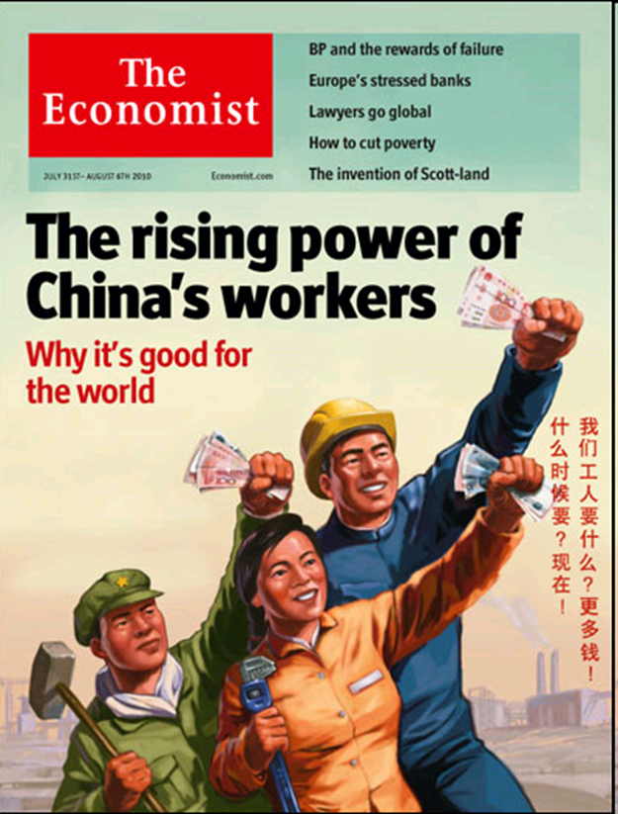
LABOUR AGENCY IN CHINA an emerging movement of resistance?
Notes:
– the retreat of victim discourse

Slide 4
CONTEXT
Transition from a command economy to a market economy
15th Party Congress
SOE restructuring
An unmaking
A ‘moment’ of (failed) resistance
Private capital and the ‘peasant worker’
Particularities
Household registration
Absence of freedom of association
No clear right to strike
And the elephant in the room…..

Slide 5
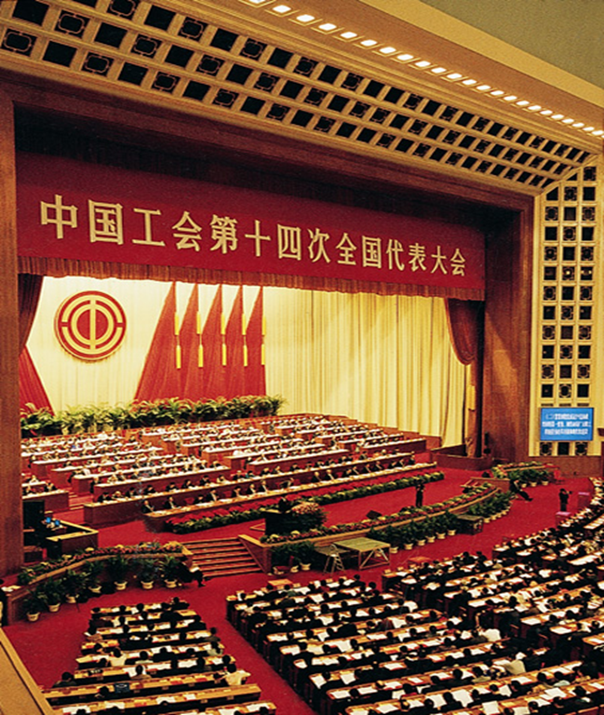
ALL CHINA FEDERATION OF TRADE UNIONS (ACFTU)

Slide 6
ACFTU
Huge!
Party led
The main problem?
老板说了算
Politically powerful
Organisationally weak
Lack of experience in capitalist labour relations
(Probably) never led a strike
Under pressure from below and above
Entirely monolithic
Pilots

Slide 7
Class formation 农民工
Household registration
Exclusion from urban welfare
Peasant workers and the ACFTU
How the state constructs labour
‘Working sister’ narratives/workers as children
How capital engages with labour
‘Nimble fingers’
Work deposits
Dormitory regime
Wage arrears
Minimum wage
managing expectations?
Guangdong

Slide 8
Guangdong
Decentralisation 天高皇帝远
Export orientated
Foreign direct investment
Deeply integrated with world trade system
Migration
Feminisation

Slide 9
Political economy of Guangdong
Led China’s jobs-led development project
Re-shaped the relationship between state, capital and class
‘Pragmatic authoritarianism’ – the construction of a legal framework for labour relations
Pioneered emergence of civil society
Qualified tolerance of NGOs
Pioneered trade union reform
Trade union elections
Experiments with collective bargaining
Pioneered changes to registration system
Most labour-capital disputes

Slide 10
Change in the balance of class forces
Rise of labour militancy
Labour shortages
Labour NGOs
Legal activism and rights consciousness
‘Class against capital’
From rights to interests
From protests to strikes

Slide 11
Four key strikes
Yantian port workers
increase wage
Workers select their own reps
Honda auto workers
Increase wage
Re-organisation of trade union
Yue Yuen shoe workers
Social insurance premiums
Watch this space…
Street cleaners

Slide 12
Some thoughts…
Globalisation and structural power
From collective bargaining ‘by riot’ to state-led collective bargaining
From structural power to associational power
Relevance of union reform/renewal?
Linking these developments to international labour movement
Does China demonstrate the impossibility of an international labour movement or its promise?

