Slide 1
Framing Work: competing analytical perspectives on the employment relationship
Edmund Heery

Slide 2
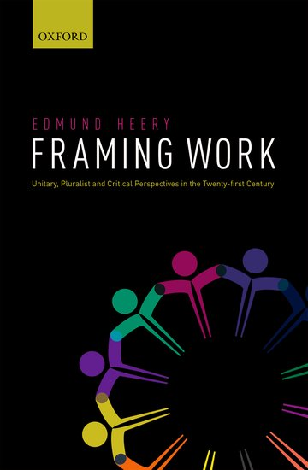
Objective of Framing Work
Existing accounts of IR field emphasise unity:
Edwards: realist ontology
Kochan: pluralist values
Brown: practical problem-solving through case study
Frege: coherent national traditions
Provide account of IR field that identifies fracture:
Unitary frame
Pluralist frame
Critical frame

Slide 3
What are frames?
Academic perspectives on work & employment
Grounded in beliefs about relative interests of workers & employers
Unitary frame – congruent interests
Pluralist frame – conflicting interests within a relationship of interdependence
Critical frame – conflicting interests
Frames are analytical
Claims about the nature of the employment relationship
Frames are normative
Prescribe desirable forms of employment relationship

Slide 4
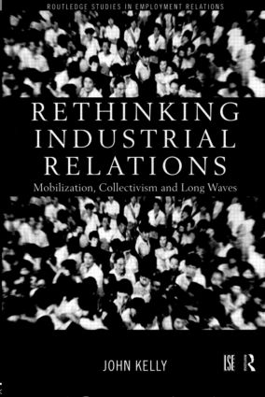
What do frames do?
Each of the three frames generates a distinctive:
Research agenda
Account of subjective experience
Explanation
Context
Agency
Critique
Prescription
Engagement
Public intellectual
Policy intellectual

Slide 5
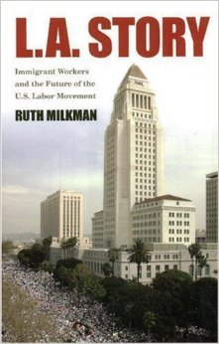
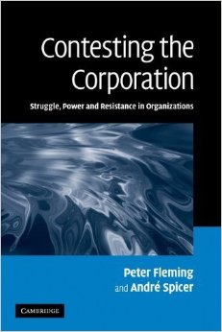
The critical frame
Critical labour studies (CLS)
Industrial Relations
Marxist
Marxisant
Critical management studies (CMS)
Organization Studies
Critical realism/lab process
Post-structuralism

Slide 6
Research agenda
Degradation of work
Managerial relations – new disciplinary technologies
Market relations – precarity
Collective relations – de-unionization
Immiseration narrative
Absolute deterioration of employment conditions & standards
Withdrawal of business & state from earlier accommodation with labour
Resistance
Workplace resistance – informal & workgroup resistance; dis-identification
Collective resistance – union renewal through militancy, organizing, coalition, internationalization
Quest for countermovement
Increasing rate, new forms & substantial effects of worker resistance
Prefigurative forms of resistance

Slide 7
Subjective experience
Discontents of the contemporary workplace
Workplace stress; emotional labour – “stressed out of my box”
Critique of seeming satisfaction/commitment
‘Subjectification’: forming of compliant subjects
Opposition to employer
Conditions for mobilization: grievance, attribution & distance
Counter-identities & ‘subversive pleasures’ of irony, cynicism & disengagement
Solidarity with others in resistance
‘Mechanical solidarity’ based on acceptance of difference
Collective workplace cultures as a basis for misbehaviour

Slide 8
Explanation: context
Systemic explanation
Enduring features of capitalism
Critique of VoC School
‘Commonalities of capitalism’
Stages of capitalist development
Era of neo-liberalism
Degradation & deregulation
Global processes within capitalism
Financialization of global economy
‘Disconnected capitalism thesis’
Counter to institutional & company-level explanations favoured by pluralists & unitarists

Slide 9
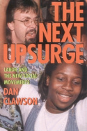
Explanation: agency
Primacy of worker agency
Ambivalence over agency of employers
Limits to management control
Systemic constraints undermine progressive reform
Ambivalence over agency of state
Globalization eroding historic accommodation with labour
Financialization leading to collapse of IR settlement in EU countries
Worker agency as a source of change
Resistance as a means of limiting employer & state power
Resistance as origin of ‘progressive’ management/IR accommodation
Resistance & punctuated models of change: decisive episodes of mobilization allow transition to new stage of development

Slide 10
Critique
Critique central to critical frame
Recurrent forms of critique in response to mainstream progressive reform
Cynicism: reform for ulterior motives;
Superficiality: reform leaves essential properties unchanged
Degradation: reform has a ‘dark side’
Incorporation: reform neutralizes resistance, consolidates control
Contradiction: reform generates perverse effects, worker resistance or is self-defeating
Recurrent critique of mainstream scholarship
Compromised through dependence on business
Ideologists, providing legitimation to oppressive techniques
Epistemic failure, producing flawed knowledge that does not provide a basis for effective management

Slide 11
Prescription
Surprising absence of prescription
Demise of utopian production within CLS
Alternative workers’ plans; Institute for Workers’ Control
Revival following Corbyn surge – nationalization, new forms of ownership?
Critical HRM within CMS
Preoccupation with critique & absence of prescription
Questioning of ontological & epistemological assumptions of mainstream
Engaging managers in challenge to ‘structures of domination’ though mechanism & agenda unspecified

Slide 12
Prescription
CLS prescription for union revitalization
Composition
Internal & external representation of women, minorities & migrants
Organizing
Bundle of ‘union-building’ best practices
Coalition
Building alliances with community organizations,
service users & environmentalists
Scale
Re-building union organization & activities ‘beyond
the workplace’
Agenda
Broadening to encompass non-work interests (work-life, sustainability); shift to post-material interests (dignity, respect)

Slide 13
Engagement
Public intellectual (CLS)
Labour strategist
Developing a vision & strategy for labour
Example: Ruth Milkman – trade unionism for
‘new gilded age’
Policy intellectual (CLS)
Scholar-activist
Providing academic skills to union & other
social movement campaigns
Example: Jean Jenkins – Burberry campaign;
Clean Clothes Campaign

Slide 14
Engagement
Engagement of CMS
Absence of institutional link to labour or other social movements
Inward focus of much engagement activity
Critique of managerialism, consumerism & marketization within the University
Defence of traditional professional autonomy

Slide 15
Interaction between frames
Contention
Classic IR Debate
Clash between pluralists & critical writers over IR reform
Example: labour-management partnership
Pluralist defence:
Partnership agreements accord with worker preferences, attract union recruits & provide unions with influence over business strategy, while enhancing performance and diffusing high performance practices; the alternative to partnership is union decline
Critical attack:
Partnership agreements are promoted by business & neo-liberal politicians and rely on bureaucratic trade unionism; they are either ineffectual or provide the means to intensify work; partnership alienates workers; the alternative to partnership is union militancy

Slide 16
Interaction between frames
Contemporary IR debate
Response of pluralists & critical writers to progressive management reform advocated by unitary frame
Example: employee engagement
Unitary proposition
Management action can generate employee engagement, producing psychic rewards for employees while raising worker performance
Pluralist response
Employee engagement is most likely to arise where collective worker voice complements management reform; in absence of voice engagement will be superficial, a fad
Critical response
Engagement is promoted for cynical reasons by unitary academics it is 1) superficial and likely to fail or 2) possesses a ‘dark side’ leading to work intensification & poor work life balance; financialization contradicts engagement initiatives

Slide 17
Interaction between frames
Internal debate
Contention between opposed positions within frames
Critical frame
Version 1 – Debate between those who emphasise extent of management control and those who stress its limits and scope for worker resistance
Example: tension between theorists of cultural control & those who perceive disidentification & misbehaviour
Version 2 – Debate over those who favour traditional union militancy and those who espouse new forms of worker organization and mobilization
Example: tension between ‘radical political unionism’ & ‘social movement unionism’

Slide 18
Interaction between frames
Realignment
Previously contending frames move closer together, blurring the boundary between traditions
Example 1 – critical pluralism
As pluralist frame has lost influence over public policy it has become more critical; engaging in critique, prescribing resistance and assuming elements of critical practice
Example 2 – defensive critique
As critical frame has withdrawn from utopian prescription it has developed a positive evaluation of and has sought to defend institutions of which it was once highly critical – trade unions, collective bargaining, works councils

Slide 19
Conclusion
Framing Work offers an interpretation of IR field which emphasises fracture, not unity
Field comprises competing unitary, pluralist & critical frames that
Offer different substantive interpretations of the employment relationship
Offer different prescriptions for reforming or reconstituting the employment relation
Competition between frames is a positive feature of the field and should be encouraged
It leads to the testing and strengthening of arguments
Challenges assumptions & breaks open cliques & sects
Identifies empirical problems and generates lines of research

