Slide 1
Euro-austerity and its implications for industrial relations
Shirley Lerner Memorial Lecture,
Manchester,
May 2015
Colin Crouch

Slide 2
Market:
Positive
Private social spending, in particular private pensions, provide the main sustainable private means used by middle-income people to insure against market risk
Outstanding consumer credit enables people to sustain consumption despite risky labour market conditions, but in a non-sustainable way
Negative:
Exposure of workers to full rigour of market forces them to adapt

Slide 3
State:
Spending on social protection
Public debt, as the non-sustainable equivalent of consumer debt
Unemployment replacement pay supports workers’ security during times of economic instability and adjustment
The public share of health spending removes a worrying form of expenditure risk from workers’ security considerations
Public spending on education achieve a similar goal as public health spending while also improving the quality of the future work force
The share of GDP taken by the state in taxes and other revenue represents the capacity of the state to manage demand
The proportion of the workforce in public employment indicates a labour force partly protected from market risks, with possible wider stabilizing effects
Spending on active labour market policy: a small but important means whereby workers can be helped to cope with risk and flexibility
The strength of employment protection law, deflated for the proportion of the workforce it protects from risk

Slide 4
Association:
The degree of encompassingness of collective bargaining, smoothing labour market risk by adjusting pay and conditions to market realities
Community:
A high level of shadow economy can provide a parallel economy countering instability in the formal one, functioning only with community protection; not sustainable in the long run
Remittances from workers abroad, stabilizing family incomes in the face of instability in the national economy
Adult sons leaving the family home late, indicating a role for the family in protecting its members during employment uncertainty

Slide 5
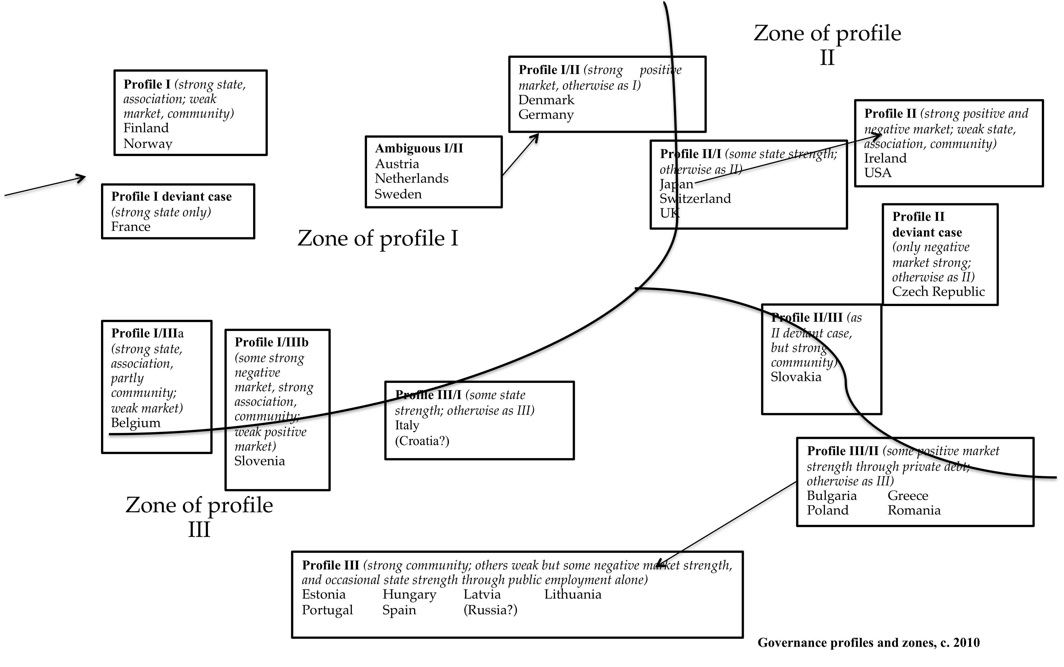

Slide 6
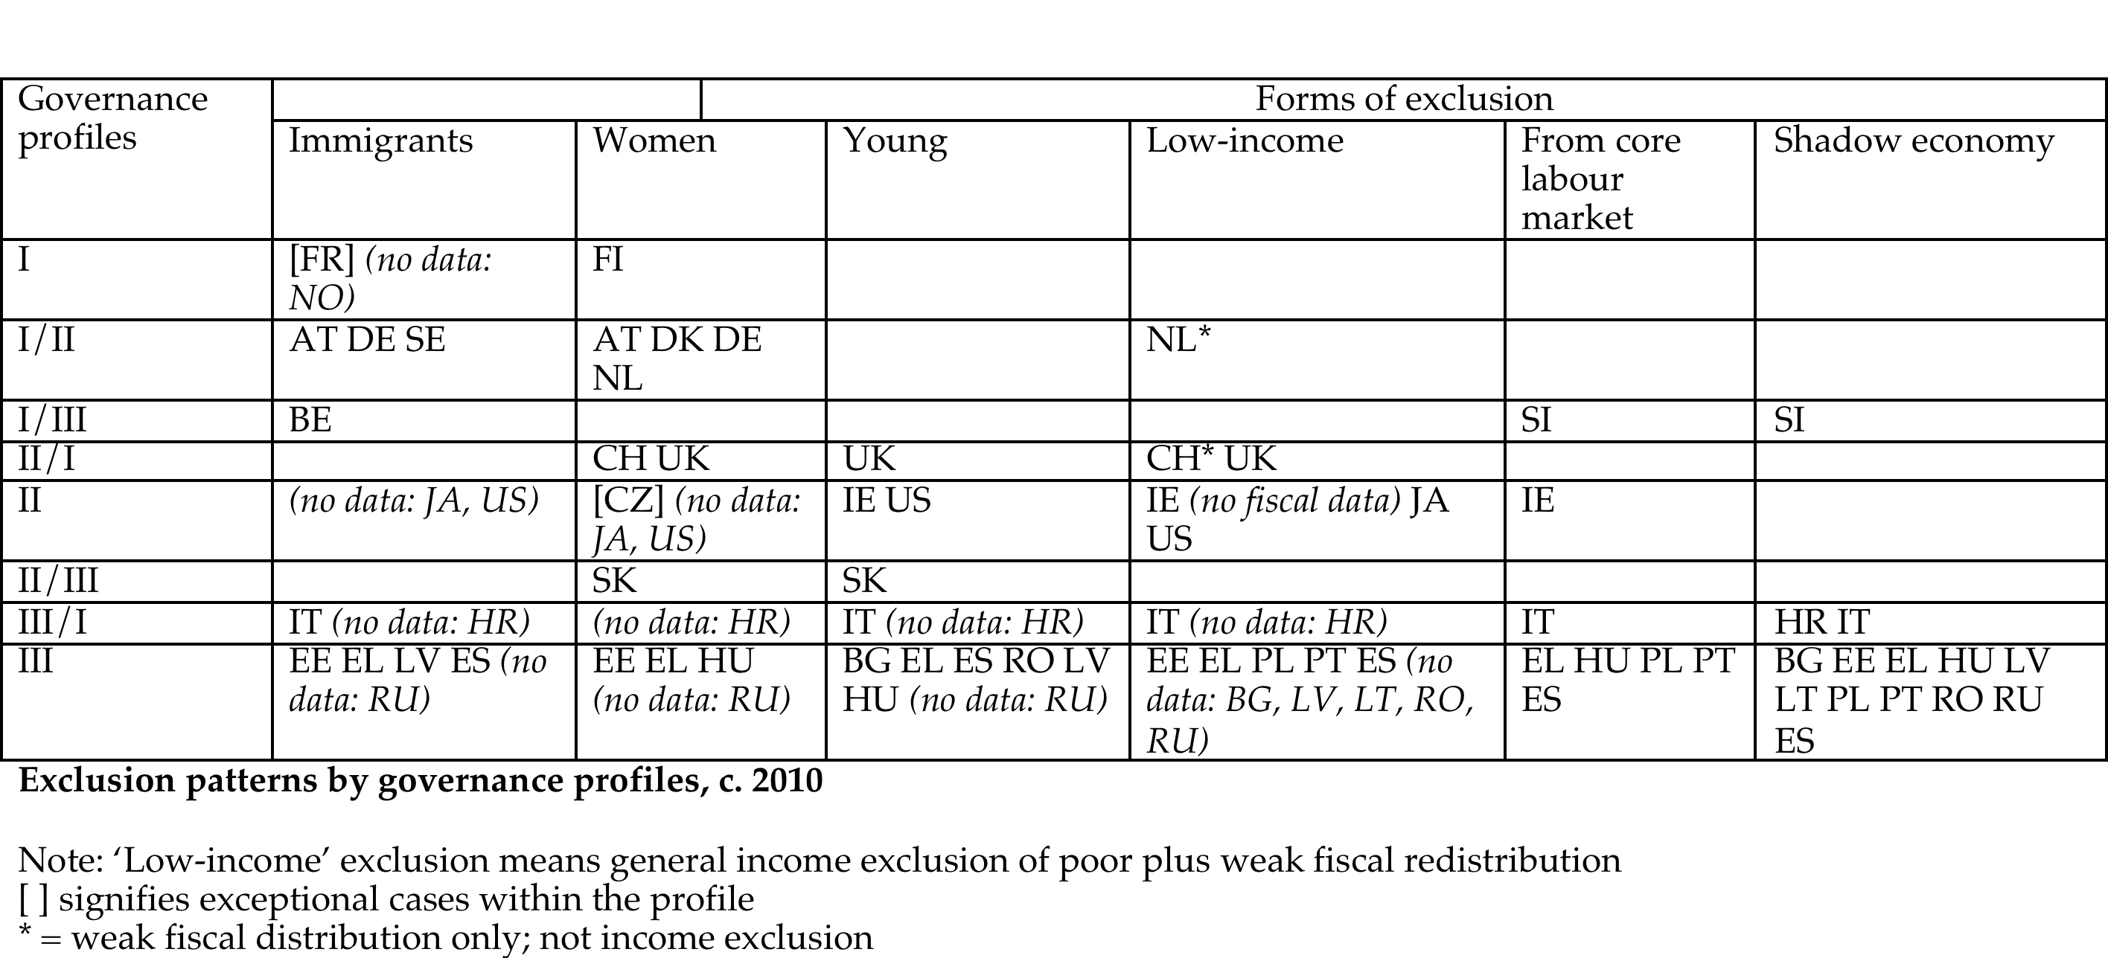

Slide 7
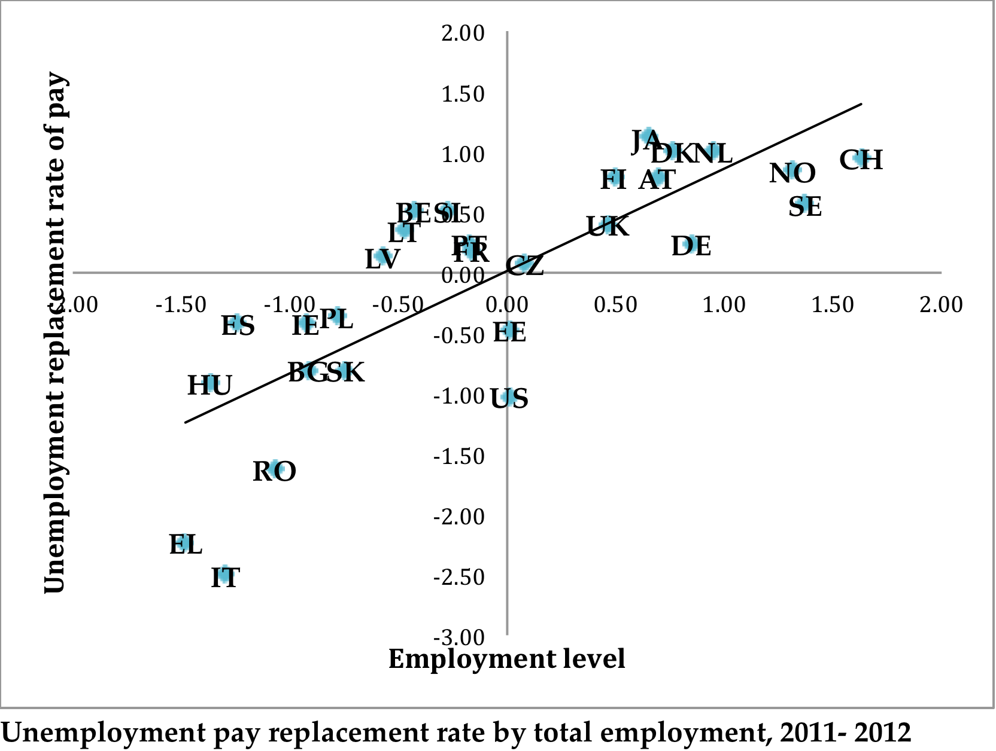

Slide 8
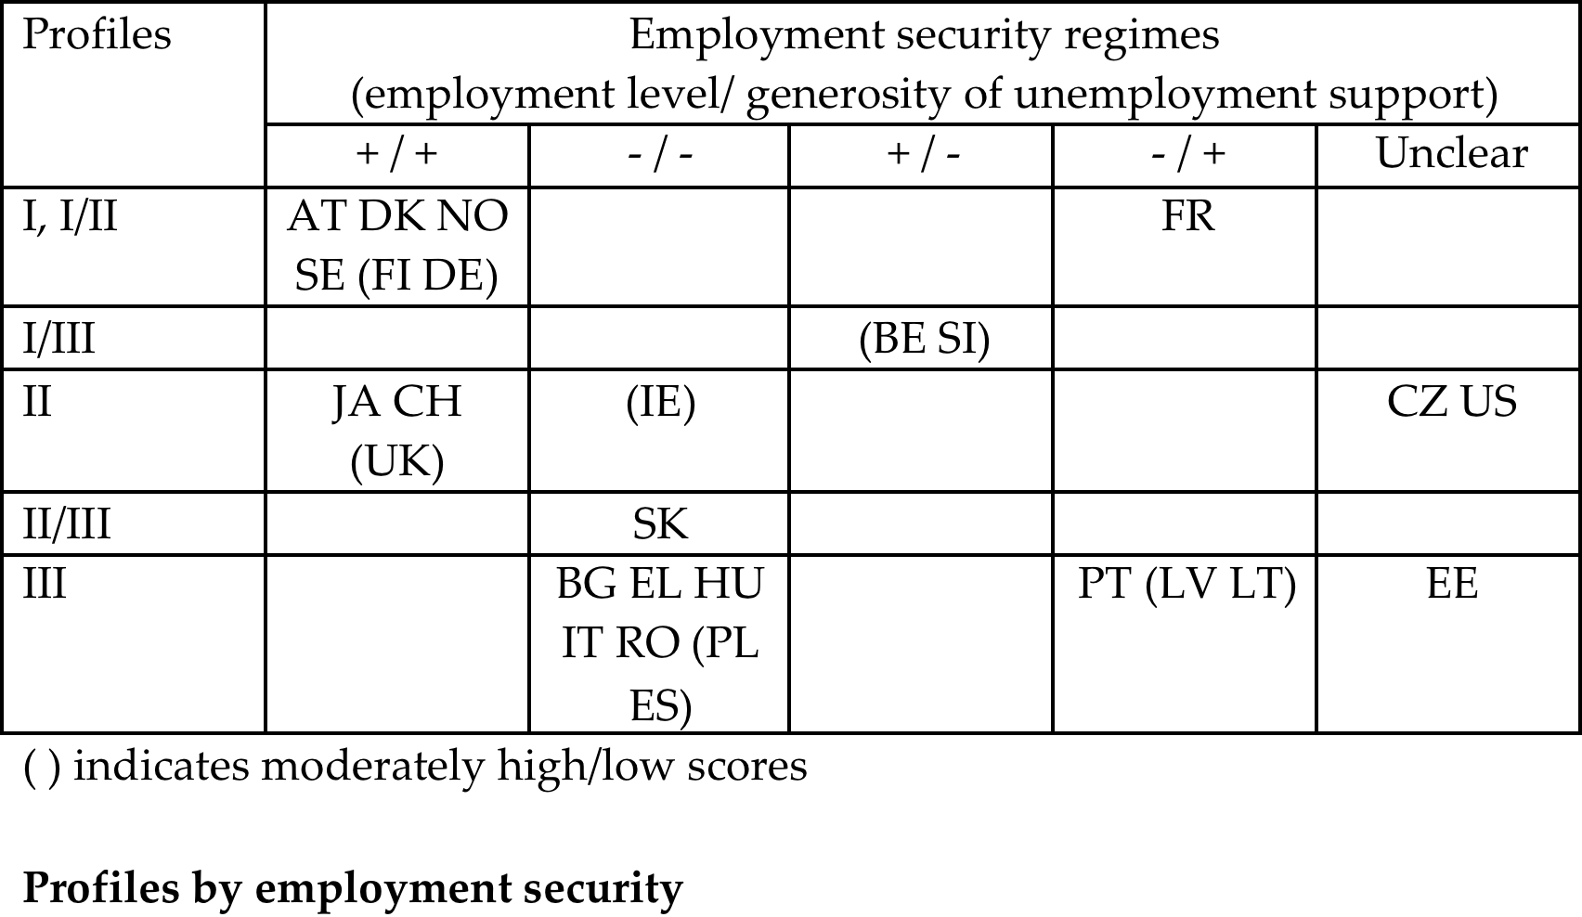

Slide 9
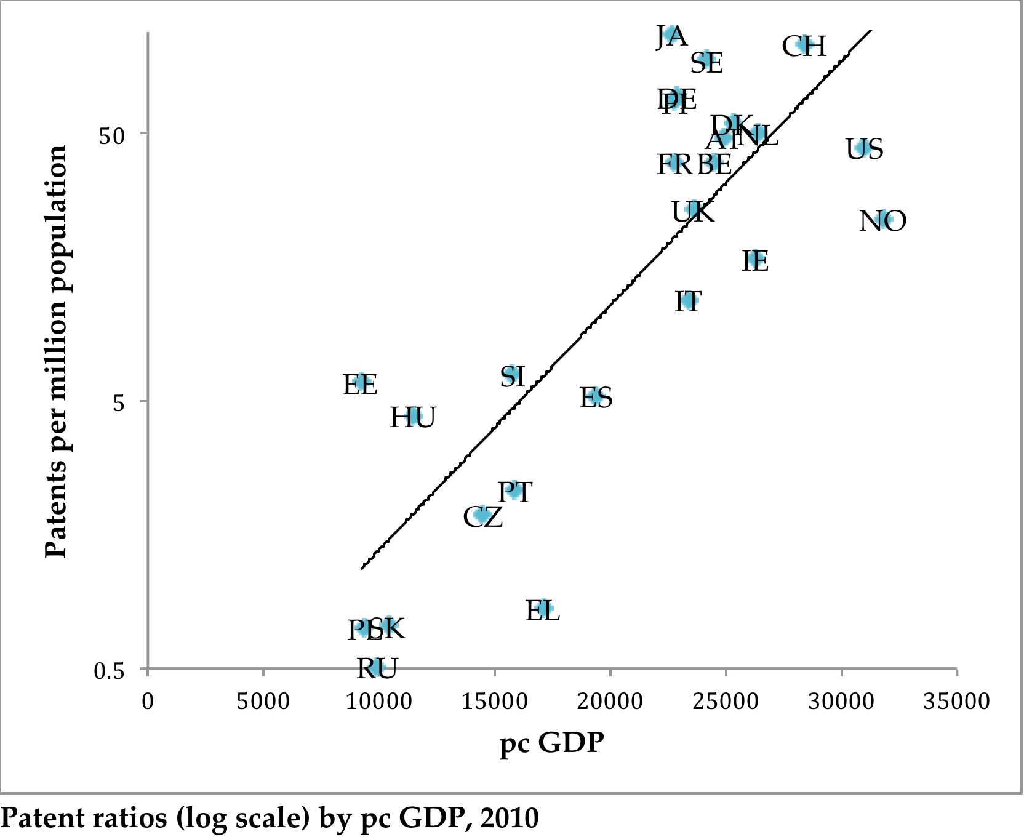

Slide 10
