Slide 1
Body work/labour and Employment Relations
Rachel Lara Cohen
Department of Sociology, University of Surrey
Presentation to Manchester Industrial Relations Society
December 6th 2012

Slide 2
Outline
Conceptualising body work/labour
Organising body labour in capitalism
  Constraints on capitalist organisation
  Possible ‘resolutions’ and their implications
    Cutting labour costs
    Concentrating body labour
    Standardising bodies
  Managing the unmanageable
    Employment Relations
    Regulation
    Social/cultural understandings
Conclusions

Slide 3
Introduction
Paid body work refers to
‘work that focuses directly on the bodies of others: assessing, diagnosing, handling, and manipulating bodies, that thus become the object of the worker’s labour’
(Twigg, Wolkowitz, Cohen and Nettleton 2011, p.1).
Occupations include workers involved in:
  care (doctors, nurses, paramedics, care workers)
  aesthetic services (beauticians, hairdressers)
  providing bodily pleasures (sex workers, massage)
  controlling bodies (bouncers, airport security personnel).

Slide 4
The body work labour force, by gender (LFS, Jan-March 1995-2010)
 |  | Body Work | Not Body Work
1995 | Total (N, 000s) | 2,677 | 22,699
 | Total (% lab fc) | 10.8 | 89.5
 | % female | 69.9 | 42.5
2000 | Total (N, 000s) | 2,947 | 24,234
 | Total (% lab fc) | 10.5 | 89.5
 | % female | 72 | 43
2005 | Total (N, 000s) | 3,153 | 25,413
 | Total (% lab fc) | 11.0 | 89.0
 | % female | 69 | 43
2010 | Total (N, 000s) | 3,483 | 25,169
 | Total (% lab fc) | 11.8 | 88.2
 | % female | 70 | 44
Note limitations
Main job only
Formal work only

Slide 5
Conceptualising Body Work
[paid] work on the bodies of others (Wolkowitz 2002; 2006; Twigg 2000; 2006).
Alternatives (see Gimlin 2007; Armitage et al 2011), include alternative therapy (bodywork), work on the self...
Specification: body work/body labour (Kang 2003; 2010). Comparable with Hochschild’s (1983) dichotomy between emotional work and emotional labour.
I employ a version of Kang’s distinction:
  Body work involves the touch or manipulation of another’s intact body.
  Body labour is the commodification of this work: body work sold for a wage.

Slide 6
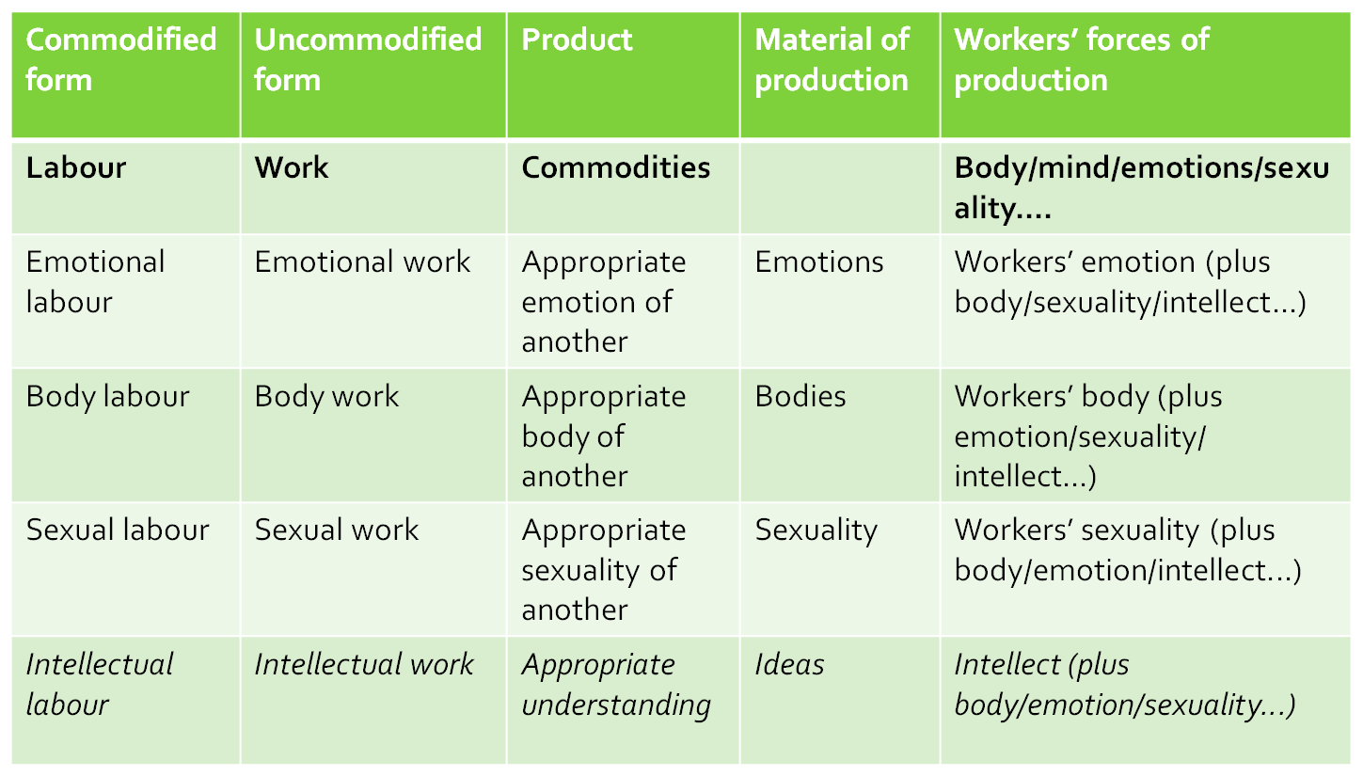
Body work/labour vs. other types of personal service work

Slide 7
The social meaning of body work/labour
Historically many forms of body work were performed as domestic labour.
Today body labour is constituted by its relation to capitalist labour processes.
Relations between the significant actors (worker/body-worked-upon) also strongly imbued with cultural meanings about:
  the body of the worker,
  the body of the worked-upon
  the social meanings of touch, intimacy and physical constraint

Slide 8
Organisation and re-organisation of the capitalist labour process
Aim: increase productivity (in constant competition)
Consequence: constant reorganisation, rationalisation and control over labour use
Given that most workers sell labour-power for limited time period (e.g. 9-5), managers have an incentive to:
  standardise the labour process (increasing predictability and ability to allocate labour),
  substitute labour with capital (often in the form of technology), or use cheaper labour
  decrease the ‘porosity of the working day’ by minimizing gaps or non-working time between tasks (Green 2001).

Slide 9
Organisation and re-organisation of the body work labour process
Previously argued that: Body work constrains labour process (re)organisation in three ways (Cohen 2011)
Rigidity in the ratio of workers to bodies-worked-upon limits the potential to increase capital-labour ratios or cut labour.
The requirement for co-presence and temporal unpredictability in demand for body work diminish the spatial and temporal malleability of the labour process.
The nature of bodies as a material of production – complex, unitary and responsive – makes it difficult to standardize, reorganise or rationalise work.
Here exploring the consequences of these constraints and ways that reorganisation has sought to overcome them.

Slide 10
Reorganising the body labour labour process – what’s possible?
Cutting costs in body labour
Reorganising (concentrating) body labour
Standardising bodies

Slide 11
A. Cutting costs in body labour
Alternative ways to cut costs :
  Absolute reduction in labour, or
  Division of labour → parts of labour process assigned to lower skill/lower paid workers.
    Many examples in health (c.f. Armstrong and Armstrong 2010).
    First nurses take on doctors tasks (Doherty 2009)... then care assistants take on nurses tasks (Bach, Kessler et al. 2010)... etc.

Slide 12
A. Cutting costs in body labour
Consequences of absolute reduction of labour:
  Unpredictability of bodies means that reduction in number of workers to bodies → likely to be unattended bodies (c.f. Greener 2013).
  Consequences of this vary by occupation.
  The ‘neediness’ of bodies and the urgency of their care are biological but also social and political questions. And, of course, economic.
Tension: balance between sporadically inactive labour and sporadically unattended bodies.

Slide 13
A. Cutting costs in body labour
Consequences of division of labour:
  Institutional interactions with the body fractured into multiple interactions
  Fractured interactions →
    less inter-corporeal learning (more difficult to ‘know the body’ in a sensory way)
    increased reliance on notes from co-workers and/or oral communication with body-worked-upon.
    Increased difficulty in eliciting oral explanations – social identity of person-body lost.

Slide 14
B. Reorganising (concentrating) body labour
Physical proximity requisite of body labour → body workers must be where bodies are
Body work unlikely to be completely off-shored.
Some, albeit limited spatial clustering/centralisation
  Argentina for plastic surgery, Eastern Europe for dentistry (Connell 2006),
  Florida for care homes (Wolkowitz 2012).
More migration of workers → site of bodies.
  To country/city: international/internal migration patterns
  To residences: mobile work as everyday practice. e.g.
    Hairdressing (Cohen 2010), Care work (Wibberley 2013)

Slide 15
B. Reorganising (concentrating) body labour
Limited attempts to reorganise body labour and relieve requirement for co-presence. None comprehensive.
Examples from health/care:
Telemedicine (Dyb and Halford 2009). Virtual links between patient and clinician, or multiple clinicians. Object is generally sloughing off advice giving functions.
Telesurgery (van Wynsberghe and Gastmans 2008). Reliant on robotics and telecommunications. Little progress to date. Studies suggest remote surgeons more likely to objectify patients.
Telecare (c.f. Lopez and Domenech 2008). More labour substitution. Focus: remote monitoring. When alarm sounds, labour is dispatched from central hub. Some concentration of work without spatially concentrating bodies worked on. Similarities with ‘electronic tagging’ of criminals

Slide 16
B. Reorganising (concentrating) body labour
To date: little reduction in absolute demand for body labour (although skill mix changing)
Risk of mental/manual division → proximate body labourer denuded of decision-making capacity
This may exacerbate existing stigma associated with body work (c.f. Isaksen 2002) → decreasing pay rates

Slide 17
C. Standardising bodies
Standardisation produces predictable and measurable materials of production.
Bodies are not standard. They vary physically and biologically, but also in terms of their communicative abilities, emotional triggers, social and political power...
Standardising bodies involves one or more of the following:
Mechanisation
Standardising up
Standardisation by transformation
Standardisation by selection

Slide 18
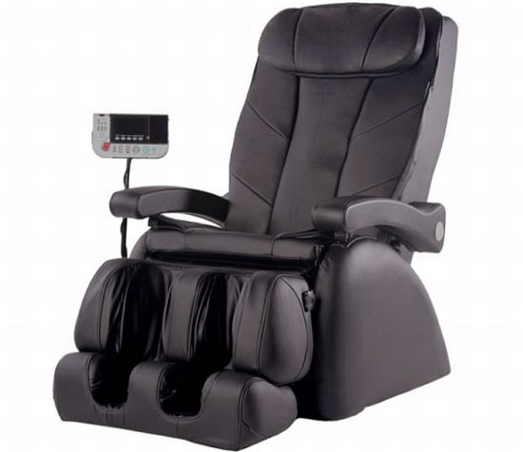
C. Standardising bodies
1. Full Mechanisation
Quite rare.
Example: Automated massage chairs. Note problems with standardizing to bodies.
2. Standardising up:
Allowing all bodies
times/resources required
by the most demanding
of bodies – expensive.
Example: exclusive body-
pampering services

Slide 19
C. Standardising bodies
3. Standardisation by transformation:
Transforming the body-worked-upon so that it is predictable. Examples:
  Residential care home residents required to be fitted with artificial feeding tubes (UK Report 2010; Rodeschini 2013)
    Palliative support and daily help both unnecessary.
  Caesarean birth rates.
    WHO estimates caesareans medically ‘appropriate’ in 5-15% of births.
    8 Country study in Latin American found consistently higher rates in Private hospitals. (Villar, Valladares et al 2006). In Brazil rates in private hospitals up to 90% (note – similarly higher in private hospitals in US)
    2008 comparative study found that a private clinic had temporal clustering of births (less on weekend, less in middle of the night) and most often had own-doctor carrying out the procedure.

Slide 20
Everyday micro-processes of standardisation by transformation...
...the worked-on-body ...is frequently anaesthetised, supine, or naked, or rendered immobile by gown or facial mud pack, making it difficult for the patient, customer or client to just get up and leave.’
(Wolkowitz, 2006: 163-4)

Slide 21
C. Standardising bodies
4. Standardisation by selection
Focusing on specific bodies
  Young, old, female...
Focusing on specific body parts
  Hair, eyes, legs...
Focusing on specific procedures on specific parts
  Cataracts, manicures...
Treats the body as its parts, not a whole, nor social entity.
Incurs ‘risk’ to the body: ignores symptoms outside the range of those normal for a procedure/group.
Increasingly medical workers are being required to do this selection with an emphasis on selecting out undeserving (medically or morally) bodies.

Slide 22
Organisation and re-organisation of the body work labour process
Cutting costs in body labour
Reorganising (concentrating) body labour
Standardising bodies
None of these straightforward.
Constraints on profitability systematic.
Therefore employment in body work dependent on specific employment structures and strategic engagement with cultural/social identities

Slide 23
Structures of employment
Public Sector Provision
  In 2010 51% of Body Work workers were employed in the public sector. In comparison, 23% of workers not involved in body work were employed in public sector. Does not include sub-contractors.
Self-employment
  Looking at private sector workers, 26% of those doing body work in 2010 were self-employed. Only 18% of non-body workers were self-employed.
  Data from 2010 LFS

Slide 24
Structures of employment
Incomplete capitalisation of body work. Often not directly subsumed to capital accumulation
  Public provision (healthcare; policing)
  State employer/funder of last resort → protected contractual relations (social care; security)
  Franchises, rather than chain stores (health; beauty)
  Own-account self-employment (therapy; beauty; sex-work; child-care)
  Informal economy (child-care; sex work; theraputic body work)
  Personalised reward systems, which also transfer risk to individual workers (tips/commission)

Slide 25
Note: how employment relations transform relations of power between body-worked-upon and body worker
Body = customer = body wanting haircut
Body Worker = employer (i.e. self-employed) = hairdresser
→ This body is in direct economic relationship to the body worker
Example 2:
Example 1:
Body = person in a residential home
Body Worker = care assistant
Employer = owner of the home
Contractor = local government
Customer (selecting service) = family
This body’s economic relationship with the worker is mediated by three other actors, including the state.
All have interests in the organisation of the work.
Example 3:
Body = customer = employer = disabled person employing home-care
Body Worker = directly employed carer
→ This body is in direct economic relationship to the body worker

Slide 26
Social and cultural location of body labour
Reliance on stigmatised workers
  Socially marginalised work. And marginalised workers
  Female workers; Immigrant workers – tho note ethnic hierarchy (varies with stigma/status of body-worked-upon)
Evocation of workers’ social identities/morality
  Discourse of professionalism intercut with discourses of risk management and humanity (often highly gendered)
  Facilitated by regulatory framework
From body labour to body work
  Carer’s allowance: £53.90 per week. ‘you must look after someone at least 35 hours per week.’ [max value: £1.54 per hour]
  ‘Big Society’: voluntary groups to take over care tasks of public services

Slide 27

Regulation of body labour
Body workers occupy a position of physical power vis-a-vis the body-worked-upon (however fleeting). The extent of power varies with relative social status, occupation, employment relations as well as physical control over the body
Formal regulatory frameworks construct the body-worked-upon as in need of protection and workers as powerful actors (c.f. Kang 2010).
Constant regulation of sexuality; clarification
of meaning of touch.
  licensing/certification
  standardisation (gowns, gloves, rules,
  written codes)
  verbal cues and jokes

Slide 28
Social construction of body labour as ‘care’
Body work in health and social services construed as ‘care work’.
  Slippage between ‘caring about’ and ‘caring for’
  Care as an absolute term: I care you don’t care he is caring she is uncaring
  Managers draw on legal and professional regulatory framework → discourse of legal responsibility (semi-hidden threat of prosecution).
‘Care standards’ regularly (inevitably) breached:
  Breaches relate to body labour (feeding, toileting, turning, bathing bodies).
  Yet, workers chastised for being ‘uncaring’ (absolute/moral). See RCN report this week on ‘Restoring compassion to nursing care.’
  Facilitates individualisation of responsibility.

Slide 29
Social and cultural marginalisation of Body labour Interactions
Body work marginalised, because…
The actual activity of body labour is ‘invisible’
  The spaces in which it’s performed are ‘private’
  Focus on emotional (‘caring about’) rather than physical (‘caring for’), without tangible product. → ‘feminine’ and natural work
Body labour is stigmatising
  ‘Dirty work’ → bodily dirt/leaky bodies
  Gendered (c.f. Widding Isaksen) and racialised (c.f. Anderson; McDowell)
Body labour does not fit popular rhetoric
  Challenges understandings of a post-modern, high-tech or virtual economy
Body labour risks sexualisation
  Touch constructed by assumptions of gender, intimacy and sexuality

Slide 30
Conclusions
The materiality and spatio-temporal location of bodies matters.
Where work takes the body as its material of production some experiences are similar, notwithstanding v different contexts
Body labour is difficult to rationalise/relocate → work likely to persist.
Bodily need is unpredictable and poorly articulated.
Attempts to increase the ‘efficiency’ of body labour involve:
  Dividing up the labour process (increasing the number of people working on any one body)
  Standardisation, often involving transformation and/or selection
  Refusing the claims of some bodies to ‘need’ body labour or forced recalibration of the temporality of need.

Slide 31
Conclusions
These transformations connected to splintering of relationships between workers and bodies worked upon → more difficult social relations / problems from insufficient communication between different workers.
Marginality and stigma →
  Invisibility of body labour
  low pay for those most intimately associated with work on bodies → dependence on marginal workers → likely to exacerbate relationship / communication problems
  Regulation largely aimed at protecting body-worked-upon (ignoring workers)
Politically important to conceptualise health/social care work as body work/labour → rather than immaterial ‘care’ if we want to explain instances of lack of ‘care’ without morally blaming individual workers.

Slide 32
Thanks
R.Cohen@surrey.ac.uk

