Slide 1
The Changing Nature of Work and Employment
European Work and Employment Research Centre
Jill Rubery
Manchester Business School

Slide 2
The Four Fs of Employment Change
Who works
From mainly men to both men and women
Feminisation
How we work
From standard to flexible employment
Flexibilisation
For whom we work
From single employer to multi-employers
Fragmentation
What work is for
From producing goods/services to financial value
Financialisation

Slide 3
50 years ago- beginnings of feminisation
1968 Women at the Ford car factory in Dagenham strike over equal pay, almost stopping production at all Ford UK plants. Their protest led directly to the passing of the Equal Pay Act.

Slide 4
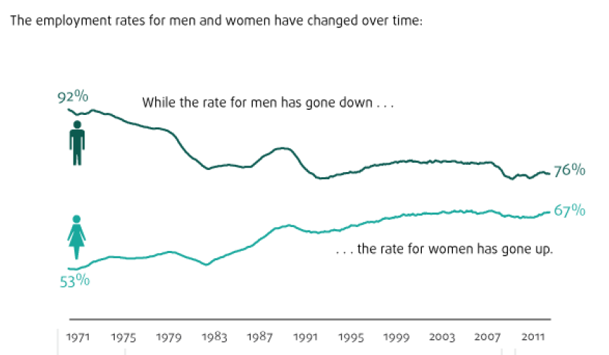
Feminisation
Share of women working 1964 to 2013 51% to 67%
End to marriage bars (1962 in Midland Bank)
Labour market participation – from M shaped to inverted U shaped.
From twilight shifts to regular part-time to flexible part-time.

Slide 5
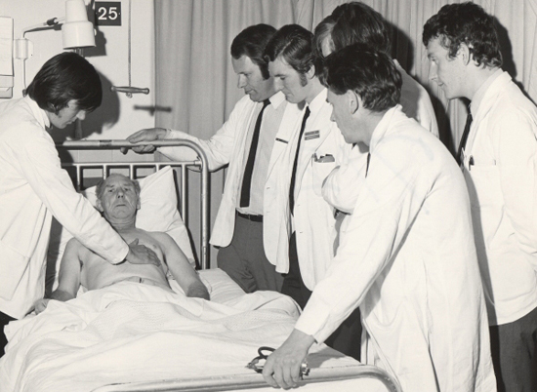
Feminisation: the impact on work and employment
Facilitated the growth of services public and private
From ‘undereducated’ to more educated than men- present in wider range of higher level jobs
But these restructured into ‘mommy tracks’ and fast tracks - reducing the gain/reconstructing segregation
Service/ part-time jobs increasingly segregated- part of fragmentation
Feminisation and flexible working time -inextricably linked but used to legitimate employer-oriented flexibility

Slide 6
50 years ago flexibilisation not yet on agenda
Contracts of Employment Act 1963
Our new Contracts of Employment Act gives employees for the first time statutory rights to a minimum period of notice. We attach great importance to the wider extension of arrangements whereby redundant workers are compensated by their employers through severance payments.
Conservative Party manifesto 1964
ITV technicians strike 1964
The union was asking for a working week of thirty-five hours instead of forty and for all crews called in from their days off to be paid double time, plus £10, plus treble to quintuple time for any overtime hours then asked for plus another day off in lieu.

Slide 7
Flexibilisation: impact on work and employment
1) Flexible jobs and flexible working time
From steady job to no long term
‘"No long term" is a principle which corrodes trust, loyalty, and mutual commitment’ (Sennett 1998).
From overtime to flexible time- 9-5 to 24/7
From guaranteed hours to ‘however long it takes’ on the one hand and to zero hours on the other hand
From workplace to anyplace ( only need mobile reception)
From regular work to work life balance?

Slide 8
2)Flexible careers?
From institutionalised to employee-led flexible or boundary less careers?
From ‘deferred’ to immediate reward
From upward mobility to cycling between low paid and insecure jobs
and back to organisational structures - still important for careers

Slide 9
From integration to fragmentation
Vertically integrated firms and nationally coordinated infrastructure
1964 in-coming Labour government committed to a national plan but never took off
Growth of conglomerates in 1960s precursor of fragmentation
‘Ironically, by turning the corporation into a portfolio, the spread of the conglomerate form also facilitated the shift away from the notion of the corporation as sovereign bounded entity. Conglomerates strained the body analogy, because they offered no credible basis for a myth of identity ‘(Davis et al. 1994).
Arthur C Clarke 1964 foresaw potential for technology to change constraints of time and space
It will be possible in that age, perhaps only 50 years from now, for a man to conduct his business from Tahiti or Bali just as well as he could from London….

Slide 10
Traditional employing organisation
Single employer-employee relationship– basis for control and employee voice
Strong firm boundaries
Management
Graded pay structure
← →
← →
← →
Sector agreement influences pay rates
← Fair comparison →

Slide 11
Networked employing organisation(s) and fragmented employment relationships
client
client
Overseas contractor
Manage
ment
Sub
contractor
Joint
Venture
Seconded
employees
Individualised
pay
Agency
Non standard contract staff

Slide 12
Fragmentation: impact on work and employment
From the integrated to the flexible firm
From all in the core -to core/periphery -to constant ‘internal versus external’ cost comparison
From responsible employers to invisible employers
From public services provided by public sector to ‘any qualified provider’
From transactional to relational contracting or to relational and transactional combined?
From national boundaries to international working
From collective identity to individualised identity/ from single employer-based psychological contract to multi-employers/multi-identities.

Slide 13
Financialisation: a tale of two industries
Banking industry
Car industry
1960s/70s- highly protected employment- no poaching
1970s/80s – expansion to building societies/ feminisation of employment
1990s- emergence of i)local call centres ‘an assembly line in the head’- 2) offshored call centres ‘India calling to the far away towns’ (Taylor)
Big bang, deregulation and development of financial markets
2000s- boom then bust
Post crash decline of call centres- move to internet banking plus reconstruction of financial markets
1960s- 1970s- Affluent Worker study/new middle class/ site of industrial action
1980s- 1990s-deindustrialisation/ closure and foreign takeovers of British car industry
2000s
‘These days, GM looks a lot more like a financial institution that happens to sell cars and trucks than a successful auto maker.’ (Business Week August 2003)
(>$800m from finance including mortgages, $83m car manufacturing)
Post crash GM bankruptcy largely due to finance arm

Slide 14
Impact on work and employment: from producing to servicing to financial value
From standardised mass production to flexible specialisation – or ‘lean and mean’
From manufacturing to services- retail dominating manufacturing ( but not new for consumer industries in UK)
From skill in production to skill in service delivery- managing emotions/ limiting complaints
From value in production to value in knowledge and information society
From producers of use value to producers of financial value
From mutual dependency in production to disposable labour and disconnected capitalism – in pursuit of financial value

Slide 15
Forces shaping change
Global
Political
Tertiarisation
Transformational technology
Transnationalisation
Deregulation
Decollectivisation of employment
Depoliticisation of employment
We economists do a linguistic disservice when we call a relationship-free, frictionless outcome “perfectly competitive.” The Luddites had it right when they complained that there is nothing perfect about that outcome at all. Frictions are our friends. Frictions give us the peace of mind that we will still have our jobs when we wake up tomorrow. Frictions reduce the chances that one party will try to “hold-up” the other, absconding with the lion’s share of the mutual benefits. Frictions thus give us the confidence to make the relationship- specific investments from which great returns can flow. E. Leamer on Freidman’s ‘Why the world is flat’

Slide 16
50 years of progress? Outcomes and future prospects
The Positive
The Negative
More in employment/ more access for women
More with education
Higher real wages- until recently
More demanding /interesting work for some
Improved health and safety
Lower physical stress levels
More insecurity
Less transparent/more ambiguous employment relationships
More fragmented careers
Less chance of upward mobility
More polarisation/ higher inequality/ decline in wage share and in real wages for middle and lower
Weakened mutual dependency due to financialisation
No long term/weakened identity/corrosion of character

