Slide 1
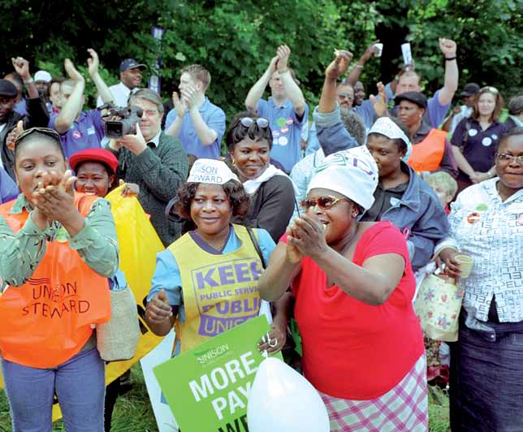
The Changing Face of Employment Relations - Equality and Diversity
Sian Moore, Centre for Employment Studies Research
Manchester Industrial Relations Society 50th Anniversary Conference

Slide 2
The Changing Face of Employment Relations – Equality and Diversity
The tension between voluntary and legal responses to discrimination as ‘vehicles for equality’ over the past 50 years;
The shifting relationship between liberal and radical models of equality;
Self-organisation as the radical political response?
Intersectionality – a liberal or radical response?

Slide 3
The Changing Face of Employment Relations – Equality and Diversity
The voluntary route – Collective Bargaining, the Living Wage;
The legal route – Equal Pay; the Equality Act;
The statutory route – Statutory union Recognition; the NMW;
The workplace – self-organisation and/or equality reps.

Slide 4
The Changing Face of Employment Relations
Approaching 50 years since the women sewing machinists at Ford's Dagenham went on strike over equal pay – where are we?
Neo-liberal capitalism and yawning wealth and income gaps on the vertical plane alongside extant social divisions and inequalities;
The growth in executive pay means that whilst in 1979 the top 10% took home 28% of the national income, by 2007 this had grown to 40%.
(High Pay Commission, 2012).
Notes:
mean hourly pay, excluding overtime;

Slide 5
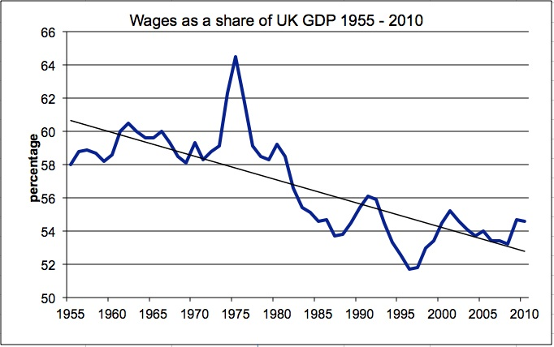
Labour’s share of GDP

Slide 6
The Changing Face of Employment Relations – Equality and Diversity
Overall gender pay gap 2014 was 19.1%, full-time gender pay gap 9.4% (median gross hourly earnings) – back to 2012 gap;
Increase in public sector from 9.5% to 11% (private sector decreased from 19.2% to 17.5%);
Part-time women earn £5.15 per hour less than full-time men – 38%.
Notes:
Less than two thirds median hourly pay

Slide 7
The Changing Face of Employment Relations – Equality and Diversity
Women, young and older workers at most risk of low pay;
22% of all workers low paid; 27% women, but proportion of low paid men has increased;
81% of those aged 16-20 and 40% 21-25;
33% aged 66 and over.
Resolution Foundation, 2013
Notes:
Less than two thirds median hourly pay

Slide 8
The Changing Face of Employment Relations – Equality and Diversity
Austerity - more than 820,000 more women have moved into low paid, insecure jobs since the start of the recession in 2008 (Fawcett Society).
Ethnic pay gap – occupational segregation and class (Brynin & Guveli, 2012);
The ethnic pay gap largely disappears for women employed part-time – the gender pay gap dominates (Metcalf, 2009);
Intersections of class, gender, age and ethnicity.

Slide 9
Collective organisation
In the UK women are currently 55% of aggregate union membership (BIS 2014), although the total has halved since the end of the 1970s.
Black British workers are more likely to be union members than ‘all employees’ (29% compared to 26% in 2013) and this is particularly true for black women.

Slide 10
What happened? The voluntary route - Collective Bargaining
Historically sectoral and exclusive;
But potential for a wider basis of collective bargaining;
Flexibility, acceptability, legitimacy, enforcement and voice (Dickens, 2000).
Notes:
Initiatives can be targeted and tailored to suit local circumstances, which may mean they are more acceptable and workable. The co-determination of equality measures may lessen resistance to them. Existing mechanisms of collective bargaining provide ready-made policing and enforcement mechanisms. In contrast to top-down legislative intervention (‘men’s rules for women’s rights’) collective bargaining, resting on representative structures, provides a way of giving women a voice, ‘an ability to define their own needs and concerns and to set their own priorities for action’.

Slide 11
Collective Bargaining
‘harnessing collective bargaining as a mechanism for the promotion of gender equality implies radical change in the traditional platforms and approaches of much collective bargaining and poses challenges to the existing nature of many trade unions’ (Dickens, 2000).
Unions reconfigure internal structures;
Self-organisation of black, disabled, LGBT and women workers.

Slide 12
Collective Bargaining
Retreat from Fordism and corrosion of national, sectoral and enterprise bargaining – removal of state support;
Collective bargaining covered 71% of workforce in late 1970s, Wages Councils set minimum pay rates for a further 11% (statutory);
2012 29% of the workforce covered, 16% in the private sector (LFS, 2012);
Proportion of workers falling below low pay threshold rose from a low of 15% in 1975 to a peak of 23% in 1996.
Notes:
statutory quasi collective bargaining bodies - of the workforce in industries in which labour organisation was insufficient to support ‘voluntary’ collective bargaining (principally private service industries employing predominantly women). They were weakened in 1986 and abolished in 1993

Slide 13
Responses to decline – Statutory Recognition
Limited scope of statutory agreements extended to voluntary – pay, hours and holidays;
Equal opportunities specified as a subject of bargaining in less than one in ten (8%) and specifically excluded in one third (31%) (Moore et al. 2004) – a procedural issue;
Fewer than one in ten (7%) agreements provided for collective bargaining on family-friendly policies;
Boots Pharmacists.

Slide 14
The fragmentation of bargaining
‘transformational governance’ in the public sector (Colling) – privatisation, outsourcing, diversification of provision;
Removal of workers from direct employment, collective bargaining coverage, existing representational structures, representation and organisation;
Contract based recognition – social care.

Slide 15
The fragmentation of bargaining
Equal Pay (ASDA);
Concentration of women, black and migrant workers in privatised services in some geographical areas (Wills et al., 2010) suggests strengthened divisions of labour on the basis of race, gender and ethnicity.
Notes:
Some successes bham, but …

Slide 16
Responses to decline – the NMW
Introduction of NMW from 1999 to improve pay at the bottom of the wage structure (Grimshaw and Rubery, 2010);
Reduction of those on extreme low pay falls from one third in 1997 to 2% in 2012 (Whittaker and Hurrell, 2013);
LPC reports that hourly median gender pay gap nearly halved from 15.9% in 1998 to 9.4% in 2013 (5.8% at bottom and 20.5% at top).
Notes:
hourly wages below one third of gross median hourly pay for all employees

Slide 17
LPC - Hourly Pay Gaps for Particular Groups of Workers Aged 22 + (LFS)
Per cent | 2007/8 | 2008/9 | 2009/10 | 2010/11 | 2011/12 | 2012/13
No qualifications | 34.4 | 35.3 | 34.9 | 34.6 | 34.3 | 33.7
Women | 19.5 | 19.5 | 17.6 | 19.1 | 17.4 | 18.6
Disabled | 11.1 | 11.7 | 9.9 | 9.5 | 8.9 | 9.1
Migrant workers | 3.9 | 5.5 | 8.2 | 7.8 | 6.1 | 7.2
Ethnic Minorities | 3.9 | 5.3 | 5.0 | 3.4 | 4.0 | 3.6

Slide 18
Responses to decline – the NMW
Increases in the minimum wage led to small reduction in hours and weeks worked (Gregg & Papps 2014);
CBI lobbying from 2006 for realignment with average earnings growth; and economic crisis – real value of NMW falls;
45% of NMW workers work 20 hours or fewer a week - around 56 per cent of NMW workers received a cut in real take-home pay in 2013/14;
NMW as benchmark for hourly pay.
Notes:
hourly wages below one third of gross median hourly pay for all employees

Slide 19
Equality Law
Article 13 EC requires action to combat discrimination on six strands – sex, racial and ethnic origin, disability, age, religion and sexual orientation;
The unification of separate anti-discrimination legislation, policies and bodies directed at specific groups;
A more integrated approach to equality – multiple discrimination?

Slide 20
Responses to decline – Equality Law
The language of the Equality Bill ‘echoes popular perceptions of equality, which focus on the idea of equal opportunities, or protection from discrimination’, ‘a fairness approach to equality’ (Squires);
Equality Act 2010 – public sector equality duty, statutory pay audits and multiple discrimination abandoned.

Slide 21
Responses to decline – Equality Reps
Refusal of Labour Government to grant statutory rights to Equality Reps;
Over a quarter (28%) of unions had provision for the nomination or appointment of ERs in the workplace (TUC Equality Audit 2012);
Individual representation with no collective bargaining role? (Daniels and McIlroy, 2009);

Slide 22
Responses to decline – Equality Reps
An abstract notion of equality as fairness - reflecting the prevailing legislative and policy trends – rather than the single-strand focus of self-organisation;
Reluctance to positively identify in terms of race, gender, class, sexuality, disability or age - a more inclusive approach to equality OR dilution?
Tension then between the equal treatment/sameness conceptions driving ER role and radical or difference perspective underpinning self-organisation?
Complementarity (generational)?

Slide 23
A return to voluntarism–the Living Wage
Mobilisations beyond the workplace engaging so-called ‘hard to organise’ workers, including migrants - largely independent of unions;
10,000 workers won a LW 2005-11 (Pennycock, 2012);
5.24 million earning below LW in 2013: 21% of all employees, 27% of women, 17% men (Pennycock-ASHE);
Increase in proportion of jobs paying below LW because of the rise in living costs (KPMG, 2013).

Slide 24
A return to voluntarism–the Living Wage?
Employers can accommodate the NMW and LW through the configuration of hours;
Zero hours contracts – unstable weekly income;
Removal of unproductive time (episodic work);
Increase in unpaid labour – unpaid women’s labour in the care sector – driven by the commissioning process.

Slide 25
A return to voluntarism – the Living Wage?
Supercedes collective bargaining?
Precludes bargaining over a range of other terms and conditions, including equality.

Slide 26
Collective Bargaining
Women are more likely to be covered by collective bargaining (Emery, 2012) – they predominate in health and education public services
Benefit more than men from the squeezed, but persistent, union pay premium (Bryson and Forth, 2010; BIS 2014)
Unions are constraining wage inequality (ibid).

Slide 27
Conclusions
Decline in collective bargaining associated with wage inequality (Brown & Marginson, 2001);
Return to sectoral collective bargaining as a key vehicle for equality (Ewing and Hendy, 2013)?
But expansive and inclusive;
Reinforces labour market segregation?

Slide 28
Conclusions
Failure of the liberal model to deliver equality;
Incorporation of feminism into the neoliberal programme (Fraser)?
Huge expansion in women’s employment – part-time, low paid, insecure;
The business case – employer-driven flexibility (homeworking).

Slide 29
Conclusions
Failure of voluntarism in the context of weakened unions;
Hardening of occupational segregation and divisions of labour through privatisation;
Austerity as a vehicle to push back gains of the past decades;
Need for self-organisation within and outside the workplace?

