Slide 1
TRADE UNION ARE MORE RELEVANT THAN might YOU THINK
Notes:
Trade unions have faced various scrutiny over the last few decades with a lot of questions surrounding their ability fulfil the role with an ever changing business environment. However in the current climate it is difficult to deny the ever presence of trade unions in business, with examples for this current year, we will be arguing that trade unions are still relevant and that they still have a place in the current climate.
We will start by discussing the legislation, current and past, ….
Then we will go on to look at trade unions in both public and private sectors,
And finally we will look at them from a collective and an individual role.

Slide 2
We need trade unions more than ever today
Global Recession
Austerity
Financial Cuts
Impact on:
Wages
Work Conditions
Exploitation

Slide 3
Thatcherised Union Perception
Modern Union Culture:
Negotiation
Conciliation
Co-determinatio
A survey by ACAS confirmed

Slide 4
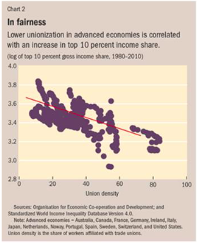
IMF and world Bank’s revelation
Less union power = Reduced wages
Poverty
Inequality

Slide 5
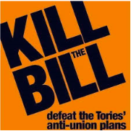
Trade union act 2016
‘Franco’s Dictatorship’ as described, by Tory MP, David Davis.
Absurd threshold of balloting and imposed by a Government, which was elected with fewer than a quarter of electorate.
Widely criticised Bill:
Amnesty International
British Institute of Human Rights
Unnecessary – Unprincipled – Unjustified!

Slide 6
INDIVIDUAL influence
WERS (2011)
INITIALLY THERE WAS A RISE IN INVIDIDUAL NEGOTIATION OF EMPLOYEES
HOWEVER FALLEN TO GIVEWAY TO OTHER ALTERNATIVES WITH TRADE UNIONS BEING VERY MUCH PRESENT BOTH INDIVIDUAL AND COLLECTIVE ISSUES.
Notes:
IT IS CLEAR THERE HAVE BEEN A REDUCTION IN THE AMOUNT OF UNION MEMBERSHIPS IN RECENT YEARS BUT WE BELIEVE THAT IT IS BOUNCING BACK.
WERS SUGGESTS THAT THERE WAS A RISE IN IVDIVIDUAL NEGOTIATION BETWEEN EE/ER HOWEVER IN THE LAST 7 YEARS THAT HAS SHIFTED TO ALTERNATIVES INCLUDNING A FELT PRESENCE BY TU’S.
This suggests that while membership and strikes has been declining to more individual negotiations, we cant ignore the presence they have for individuals in the organisations that are less reported in the media.

Slide 7
STATISTICS
WERS (2011)
INDIVDUAL
DISCIPLINE OR GRIEVANCE, HEALTH & SAFETY, RATES OF PAY, PENSION ENTITLEMENTS, HOURS OF WORK, HOLIDAY ENTITLEMENTS, EQUAL OPPORTUNITIES, PERFORMANCE APPRAISAL, RECRUITMENT AND SELECTION.
COLLECTIVE
HEALTH & SAFETY, RATES OF PAY, STAFFING LEVELS, PENSION ENTITLEMENTS, HOURS OF WORK, HOLIDAY ENTITLEMENTS, EQUAL OPPORTUNITIES, TRAINING, PERFORMANCE APPRAISAL.
Collective bargaining coverage (%)
All Employees
1980 82.0
2010 30.9
2015 27.9
Over the last 30 years on average bargaining power has steadily decreased by 6% every 5 or so years – in the last 5 years that has dropped to just 3%.
Notes:
This is further concluded in WERS (2011) as they have a clear presence in dealing with issues relating to disciplines and grievances, hours of work, rates of pay etc. This suggests a shift in their duty from solely collective to reach that individual level as well – not forgetting they are needed on a collective basis as show in recent months for example Diageo and their pension scheme being cut whilst giving their chief exec a 3.5% pay increase to a whopping 8.8m. WERS (2011) also suggest Union representatives were more likely than non-union representatives to say their time was equally divided between collective and individual issues (21% and 8% respectively).
There is evidence to suggest even those with the whitest of collars and the longest string of letters after their names can still be ashley-fied in relation to sports direct’s Mike Ashley – look at the Doctor’s strike even highly educated professionals are getting treated that badly by the ‘business’ they work for they they need industrial action to seek the support of their concerns.

Slide 8
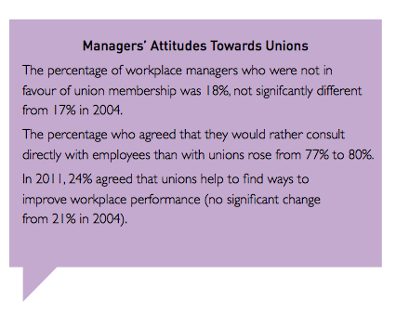
Workplace Partnerships
Has the scope to benefit both sides of the table:
Kochan & Osterman (1994)
Opportunities for greater influence over management
Increased access to information
Potentially increased involvement
TU’s still have a collective goal but working with the business rather then against them
Less hostility
WERS (2011)
Awareness that TU’s can have an impact on workplace performance
Although managers would rather consult directly with EE this might be due to not wanting to give up any control
There almost no change in 7 years for management who were not in favour of union membership
WERS (2011)
Notes:
Workplace partnerships are of growing popularity with the aim that organisations and trade unions work together to create the best environment for employees and business. (Bacon and Samuel 2009), Roche (2009) say partnerships have enhanced intrinsic benefits for employees with Unions gaining influence and increased membership. This means more opportunities, access to information, increased involvement and a better environment all round – for example Tesco and Usdaw have had the agreement for decades and reviewed in 2004 – if they weren't relevant surely Tesco would have called an end to it.
Usdaw have over 164,000 members in tesco stores and this agreement co-operates:
Employee involvement
Employee engagement
Employee voice
Invaluable feedback
Co-operation
Communication

Slide 9
The facts don’t lie
6.4 Million people in the UK are members of a trade union
55% of trade union members in 2015 were female
Royal College of Nursing– 429,414 (2014-2015)
GMB – 625,234 (2014-2015)

Slide 10
Trade union membership
Notes:
What decline?
Yes we all know that there has been a decline since the 1980s but this is largely to do with the changing nature and environment
Steel industry – on the brink in the UK – all from china
Mining industry – UK non existent – these are HUGE and HEAVILY unionized industries that are no longer a player in employment – therefore you would expect to see a decline
- But actually what you are seeing is stability AND in actual fact some increases – albeit small but increases non the less – THEREFORE THEYRE RELEVANT

Slide 11
DO You still think they aren’t relevant?
Notes:
One of the ways in which unions are moving with the times and are modernizing
A anti-union government is seeing the benefits of them
Unions can work together to come up with innovative ways to engage staff – HR (fewer people within it)
ULF projects continue to support learners to access a wide range of learning activities from literacy and numeracy to higher levels skills.
now a stronger emphasis on functional skills (notably maths), vocational qualifications and apprenticeships reflecting current skills strategy priorities of the government
A third of employers (32%) report that organisational performance has increased as a result of union learning and nearly half (47%) that employee commitment has improved.
or every £1 invested in the ULF there is a return to the economy of £12.30
The primary objective of the ULF is to develop the capacity of trade unions and Union Learning Representatives (ULRs) to work with employers, employees and learning providers to encourage greater take-up of learning in the workplace.
s main aims are to: help unions to become learning organisations; broker learning opportunities for their members; identify and share good practice; promote learning agreements; research union learning and skills needs; and support union members on learning and skills bodies and help shape sector skills agreements.
£14m invested by the Government
Helping people reskill
Gain qualifications

Slide 12
Opportunity for trade unions
Young people are the most vulnerable section of the work force
Only 8% union members
3x more likes to be unemployed, on zero-hours contracts or agency workers
‘FLEXPLOITATION’
Young workers with a union get a 42.7% wage premium than their non-union counterparts.
Notes:
Young people a key issue is ER/IR/HRM at the moment – wage premium: if unions can raise awareness (ONS suggest 42.7%) then this could be hugely significant

Slide 13
So in conclusion…

