Slide 1
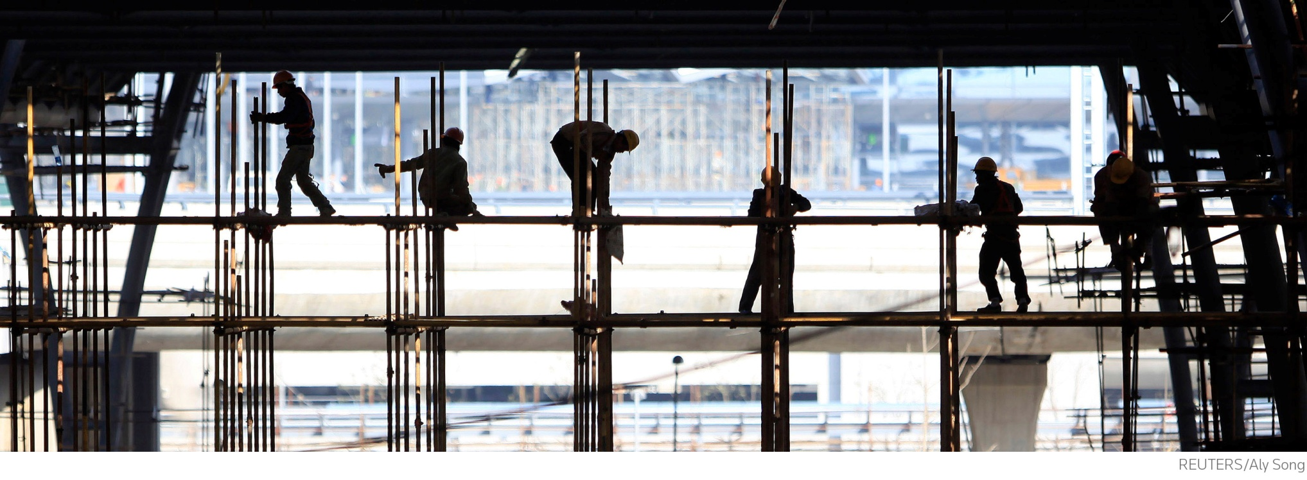
The pay squeeze: implications for ER
Ken Mulkearn, Head of Pay & Research, IDS
Manchester Industrial Relations Society 5 December 2013
Notes:
Intro
Thanks for coming…
Me – broad themes
Jon Taylor – numbers and more detail
Benefits – John Robertson
Also flag up Ken Mayhew on economic outlook, panel on specialist pay and two very interesting case studies

Slide 2
Pay awards in 2013 from IDSPay.co.uk
Notes:
Chart of pay awards recorded by IDS in 2013, based on over 500 pay settlements so far, covering over 5 million employees.
Looking at the year so far, the real main picture is a lack of variation on pay awards in 2013 compared to most years. Like in 2012, the median pay settlement we’ve recorded for the whole economy is 2.5%. But where last year we talked about an economy moving at different speeds, this year we’ve seen a real return to uniformity. Half of all settlements fall into this middle bar here, between 2 and 2.9%, and a lot of that bar to the right of it is accounted for by deals at 3% exactly. In all, more than two-thirds of settlements fell between 2 and 3% inclusive. For comparison, the figure last year was only just over a half
We’ve seen a real collapse in top-end deals at 4% and above, and also a decline in awards at 2% and below. Pay freezes accounted for 12% of freezes last year, that’s down to 8% this year. More than a third of those deals in the first two columns are in the public and not-for-profit sectors, or industry-wide deals.

Slide 3
Sector-by-sector outcomes 2013
Manufacturing median pay award – 2.5%; private services – 2.5%; not-for-profit organisations – 2%; public sector – 1%
Below 2.5% | At 2.5% | Above 2.5%
Construction (1.75%) | Engineering | Aerospace & defence (3%)
Retail (2%) | Financial services | Chemicals (2.8%)
Pharmaceuticals (2.4%) | Food, drink & tobacco | Energy & water (3%)
 |  | Motor industry (3%)
Notes:
As ever, different sectors are moving at different paces. But again, this time last year we were talking about a 4.5% median in car manufacturing, a 3.4% median in chemicals. Now we’re still really talking in a range from 2 to 3%, apart from the public sector and construction.
Construction pay awards have been below the whole economy median for a while. Retail is a slightly more mixed picture – food retail has maintained performance throughout the recession, and we’ve not seen any freezes recorded at food retailers, but other areas have been weaker.
In the most recent figures we’re seeing slightly higher increases in manufacturing than in services, and you can see there that the higher-paying sectors this year are motor industry, utilities, aerospace and defence. But actually over 2013 as a whole, the median for both services and manufacturing comes out at 2.5%.
Of course in all this the public sector is a different story, constrained by govt. policy to increases of 1%. Not-for-profit sector at 2% is a slightly more mixed bag – some care providers and housing associations have been hit hard, some other charities have perhaps fared a little better.
Next up we’ll be looking at retail awards, many of which are being settled around about now, and the motor industry payround, which will be starting shortly.

Slide 4
Average Weekly Earnings (AWE)
0.7% earnings growth across economy (September 2013)
Total earnings in private sector up 1.1%, public sector flat
Why is earnings growth below pay settlements?
Don’t measure the same thing – AWE affected by different changes in pay and labour market to IDS pay settlements
Overtime, working hours, bonuses, market adjustments and shifts in structure of workforce all affect AWE
Notes:
Don’t want to go into too much detail about average earnings, but some of you may have noticed we’ve seen low growth in the official earnings figures for a while now – you can see average weekly earnings in the most recent figures just 1.1% higher than they were at the same time last year.
Spend a quick minute looking at why that is – we do get asked sometimes why average earnings growth is around 1% while pay settlements are at 2.5%.
Measuring different things – average earnings looks at the total amount paid across the economy and how that works out per person, so it’s heavily affected by population shifts. For example, if there is a shift towards part-time work, which was a feature of this recession until recently, or jobs being created are low-paying or short on hours, the total amount earned by the UK workforce per person will be forced down. Means any growth in pay that we measure in pay awards is subdued and disguised.

Slide 5
Real wages negative since pre-recession
Notes:
One reason why engagement might be an issue is that when it comes to employees’ spending power, their pay isn’t cutting it
They might not blame employers for this (and this is probably one reason why pay rises haven’t been even lower) but perhaps they might welcome some restoration of their spending power?
Potential pressure for catch-up, but question arises of capacity to achieve this...later
And seeing as we’re talking about pay pressures, knowing how you compare on pay is critical – next slide...

Slide 6
The labour market
Notes:
Introduce by talking about Bank of England’s new approach to interest rate-setting – ‘forward guidance’ includes a link to unemployment, with Bank saying that only once unemployment comes down to 7% will they consider raising interest rates, and even then they still might not...
Then explain what graph shows – forecasts of unemployment...
Most see it coming down, but only very slowly, and only one (Nomura) thinks the target will be reached, by the end of 2014
By contrast, other outlier at top Capital Economics thought it would even increase, but they’re on their own in this, and might even have revised their view since...

Slide 7
Changes in public sector employment 1992-2012

Slide 8
Inflation outlook
Notes:
Forecasts for RPI from City economists
Direct audience to far right column which shows ave prediction for August onwards – they see it coming down a bit, but not by much, so perhaps it might remain around 3%?

Slide 9
Business investment

Slide 10
What might happen on the reward front in 2014?
Influences on reward in 2014
Upward pressure? | Downward pressure?
Economic recovery and potential impact on business investment | Fragility of recovery and susceptibility to external shocks
Recruitment and retention issues | Slow pace of recovery in labour market
The role of reward in employee engagement | Inflation forecast to stay flat into 2014
Notes:
Useful way of thinking about potential pressures on reward
Broad agreement that recovery has started, but may be fragile (nod to Ken Mayhew)
Business investment could be important – will say more about this in a moment
As recovery takes hold, r/r issues likely to rise up the agenda, but labour market could be slow to recover – again, more shortly
Employee engagement is a hot topic – can reward influence it? Big debate here...
Finally, inflation is forecast to stay flat or perhaps slowly come down into 2014. If that’s right, it will take some of the pressure off those responsible for setting pay at a time when other pressures might be burgeoning...

Slide 11
Employers’ intentions for 2014
Notes:
We run a subscriber survey every year, some of you may have taken part, this is one of the questions in it – do you expect to award your annual pay increase at a higher or lower level next year.
Most employers intend to award similar increases in 2014, but a significant proportion expect to pay higher than they did in 2013. Over a quarter. Indication is that employers expect the picture to be broadly the same, but some companies could make higher awards. On the basis of this we’d say we won’t expect see many pay increases any lower than we have this year, but whether enough will award significantly higher increases to drag the overall median up, it’s too early to say.

Slide 12
People issues
Notes:
Say what graph shows and where it comes from (subscriber survey)
Top items is r/r – big change from last year’s survey when ee engagement was top, and r/r was much further down
Ee engagement still there, but keeping labour costs in check comes in a close third
So what does it all mean?
The rising concerns over recruitment and retention are linked to the apparent change in the economic outlook – poss that upturn in activity is coming.
And the worries about employee engagement could reflect the way in which the long recession, and its effect on incomes, has had an impact on staff motivation.
The continued focus on costs perhaps presents a conundrum, since it is not always easy to reconcile this with the top two concerns.
But maybe there are ways of squaring the circle, by being inventive…
Talk of engagement – next slide…

Slide 13
The rise of the ‘Living Wage’
Notes:
Describe graph...
Reason for rise in prominence of Living Wage
Also reason why Vince Cable, Business Sec, has asked LPC to consider how NMW might be able to rise faster in medium term
Likely change in LPC remit to reflect this...
TUC wants higher mins in sectors that might be able to afford it – not sure they’ll get this but brings me to my last slide...

Slide 14
Thank you very much – questions welcome
020 7422 4937
ken.mulkearn@thomsonreuters.com

